Slide 1
6. sums & asymptotics
CSI 2101: Discrete Structures
Andrej Bogdanov

Slide 2
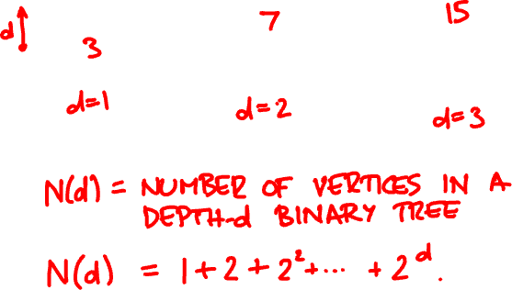
perfect binary tree

Slide 3
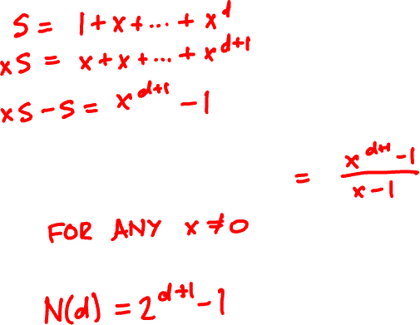


geometric sums

Slide 4

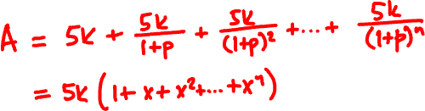
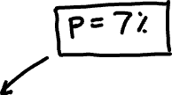
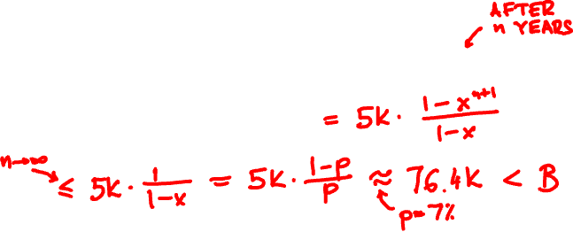
annuities
1 Jan 2024 → $5000
$80000
1 Jan 2025 → $5000
1 Jan 2026 → $5000
…
A
B

Slide 5

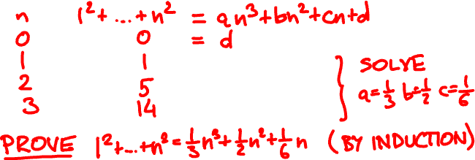
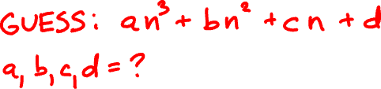
polynomial sums
1² + 2² + … + n² = ?

Slide 6







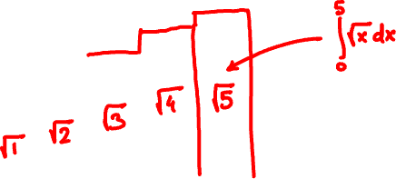
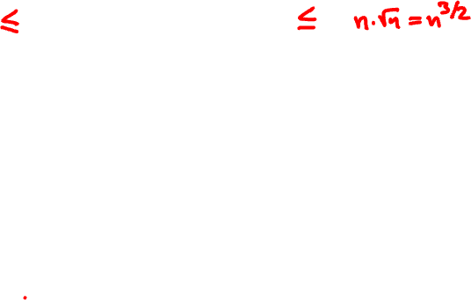


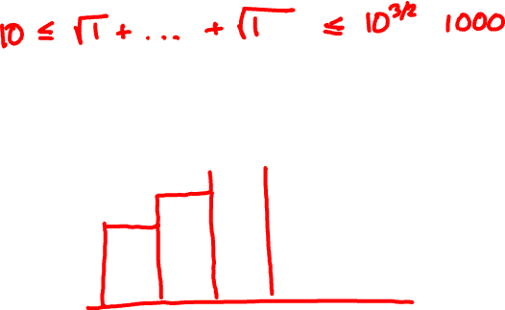



approximating sums
√1 + √2 + … +√n = ?

Slide 7


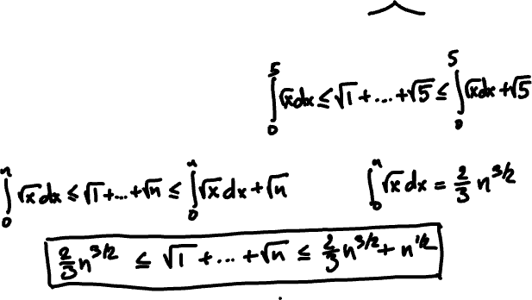
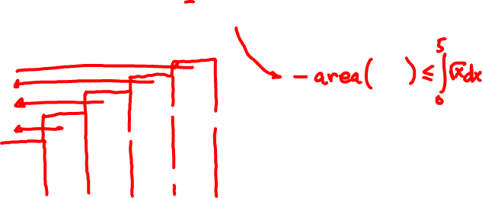
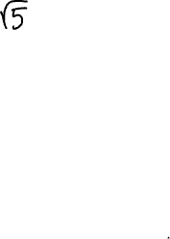


Slide 8


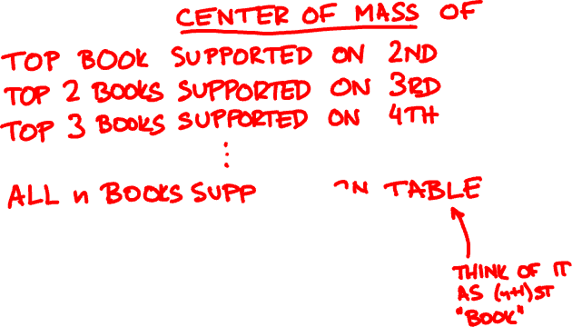
overhang

Slide 9

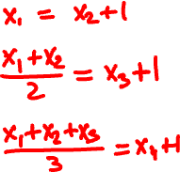
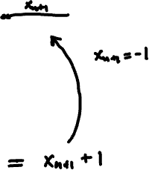
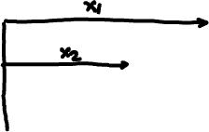

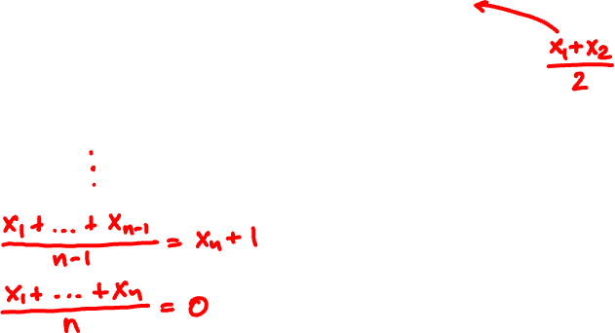
2

Slide 10


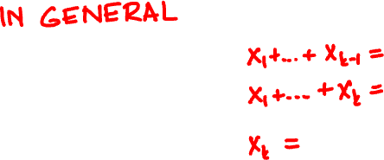
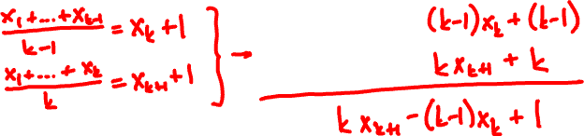
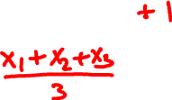
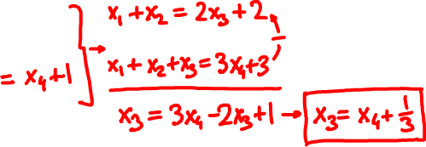

Slide 11



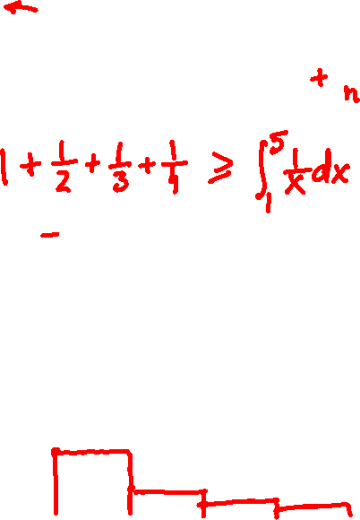

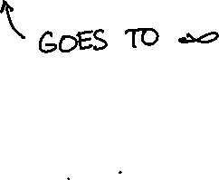
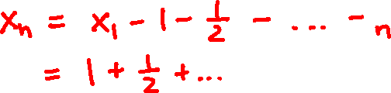

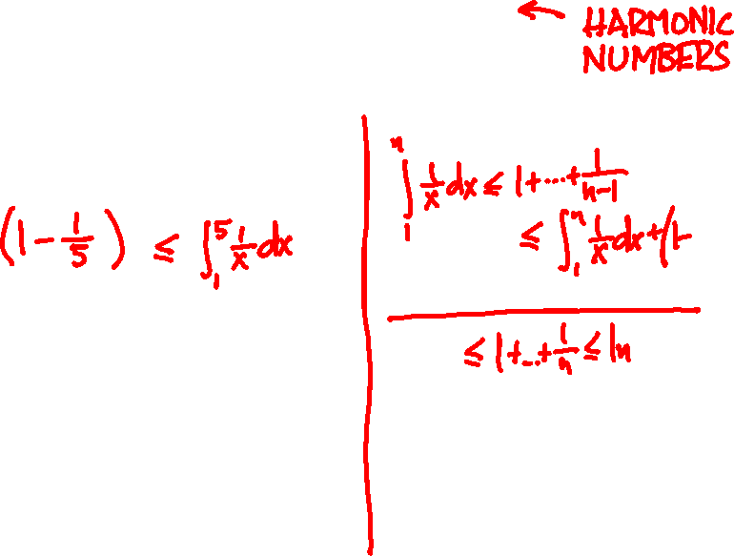

Slide 12
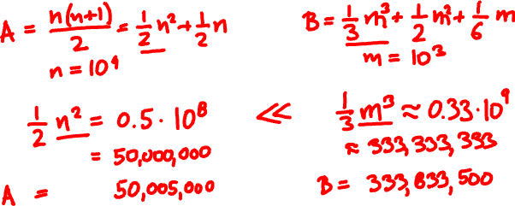
asymptotics
A = 1 + 2 + … + 10000
B = 1² + 2² + … + 1000²

Slide 13
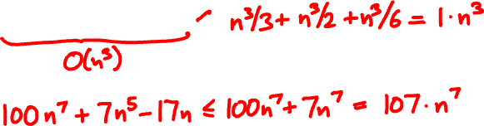
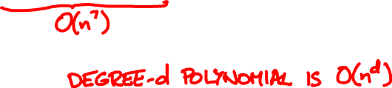
big O
f is O(g) if there is a constant C so that
f(n) < C∙g(n) for all sufficiently large n.
n³/3 + n²/2 + n/6 =

Slide 14
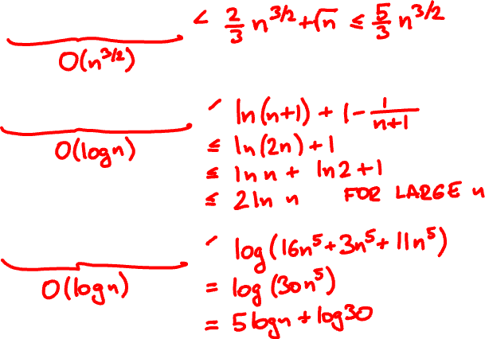

√1 + √2 + … +√n =
1 + 1/2 + … + 1/n =
log(16n⁵ + 3n + 11) =

Slide 15
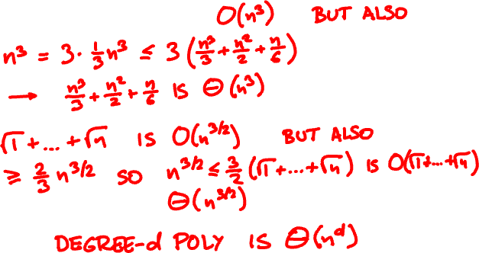
big Theta
f is Θ(g) if f is O(g) and g is O(f)
n³/3 + n²/2 + n/6 =

Slide 16
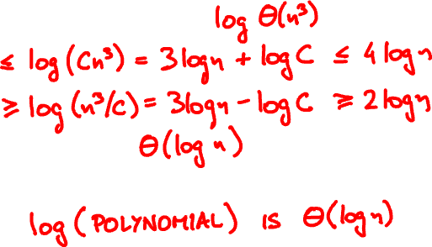
big Theta
f is Θ(g) if for some C and large n
g(n)/C < f(n) < C∙g(n)
log(16n⁵ + 3n + 11) =

Slide 17
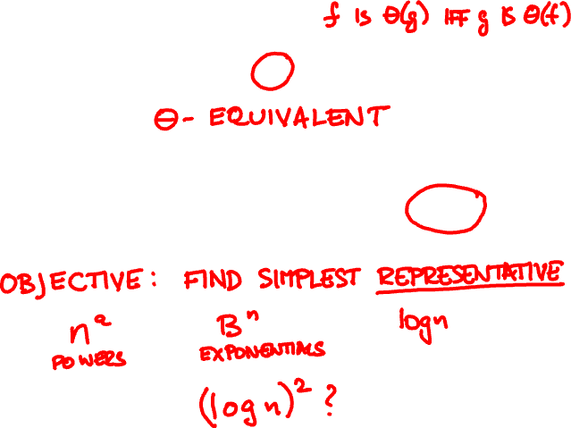
basic functions
n(n+1)/2
n²
0.1n² – 10n
5log(n² + n)
lnn – √lnn
log n

Slide 18

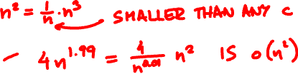
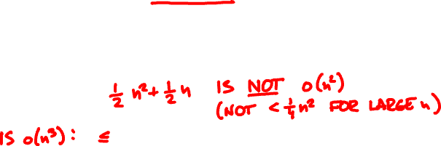
little o
f is o(g) if for every constant c and
all sufficiently large n, f(n) < c∙g(n)
n(n+1)/2 =
n^{1.99} + 3n^{1.54} =

Slide 19
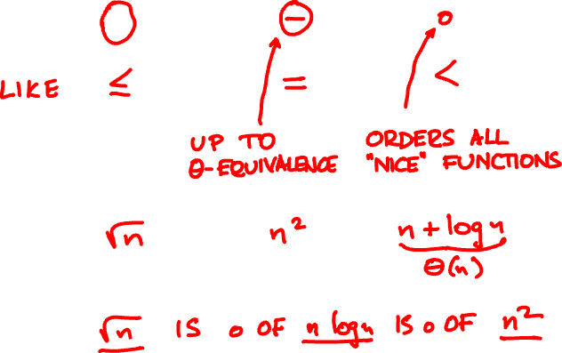
asymptotic order

Slide 20
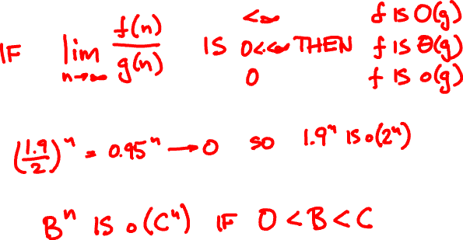
asymptotics from limits
1.9^{n}
2^{n}

Slide 21
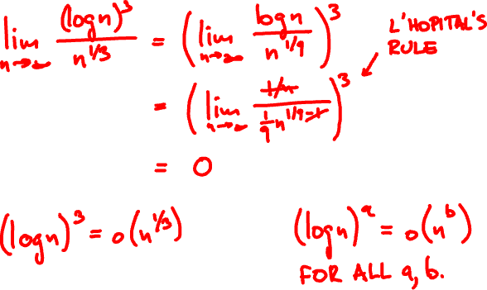
exponential growth
(log n)² vs √n?

Slide 22
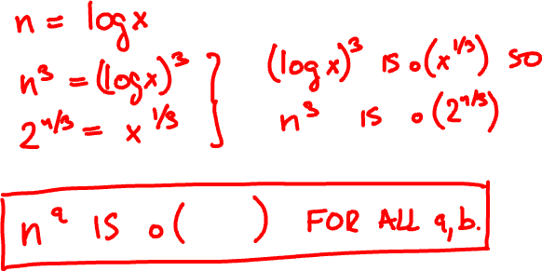

n² vs 2^{n/2}?

Slide 23
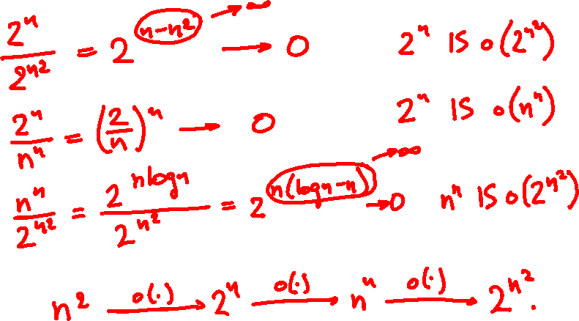
Order these functions asymptotically:
n^{n}
2^{n}
2^{n}
n²
2

Slide 24
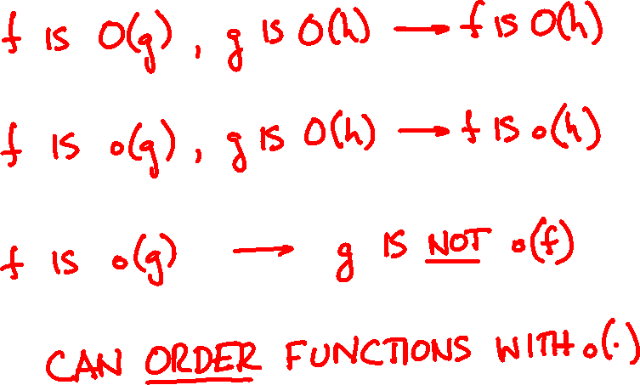
properties of O(∙) and o(∙)

