Slide 1
6. sums & asymptotics
CSI 2101: Discrete Structures
Andrej Bogdanov

Slide 2
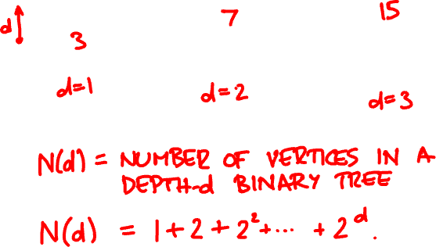
perfect binary tree

Slide 3
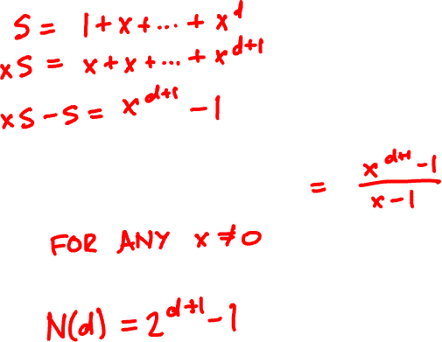


geometric sums

Slide 4

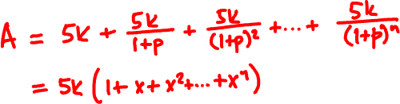
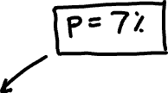
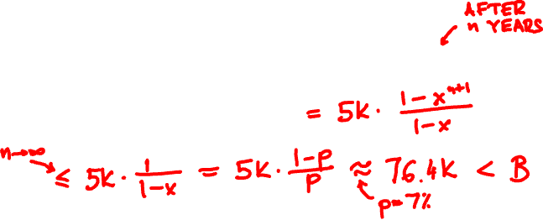
annuities
1 Jan 2023 → $5000
$80000
1 Jan 2024 → $5000
1 Jan 2025 → $5000
…
A
B

Slide 5

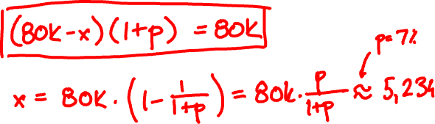
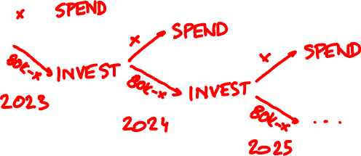

Slide 6

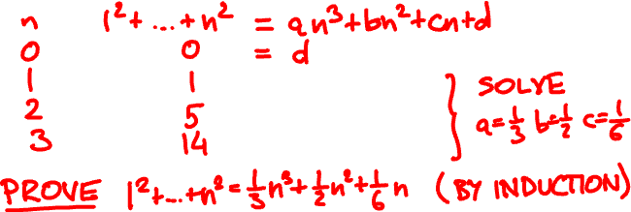
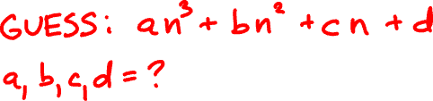
polynomial sums
1² + 2² + … + n² = ?

Slide 7
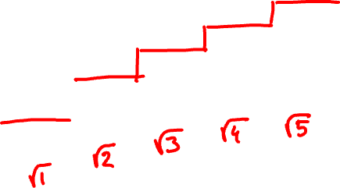
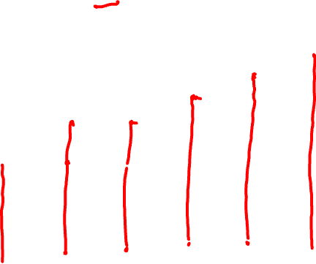
√1 + √2 + … +√n = ?

Slide 8


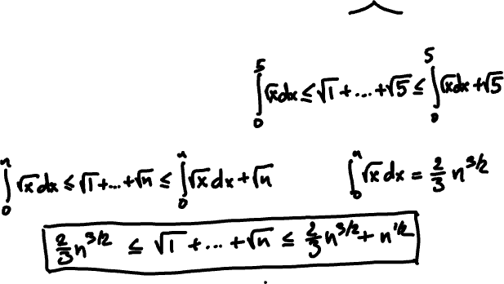
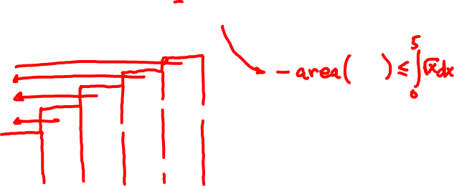
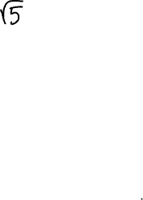


Slide 9
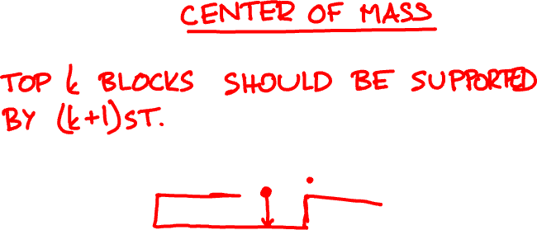
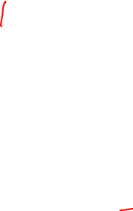

overhang

Slide 10
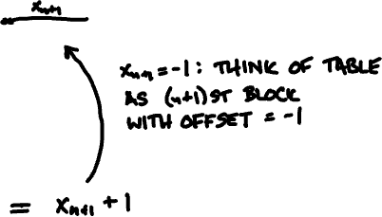
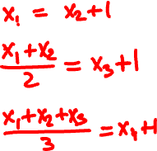
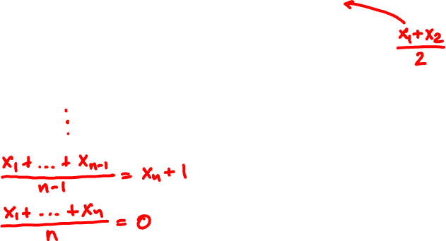
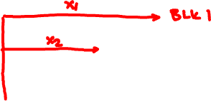
2

Slide 11
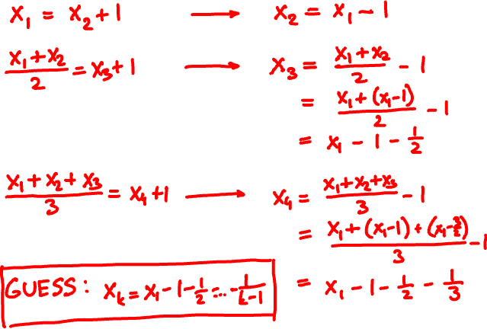

Slide 12

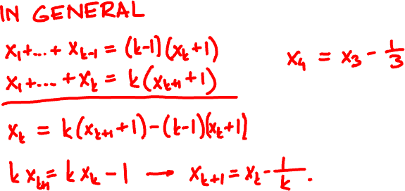
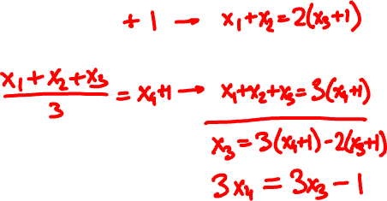

Slide 13



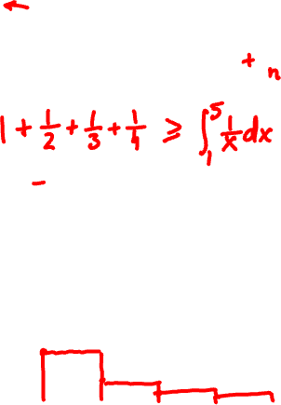

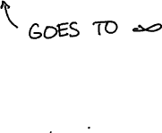


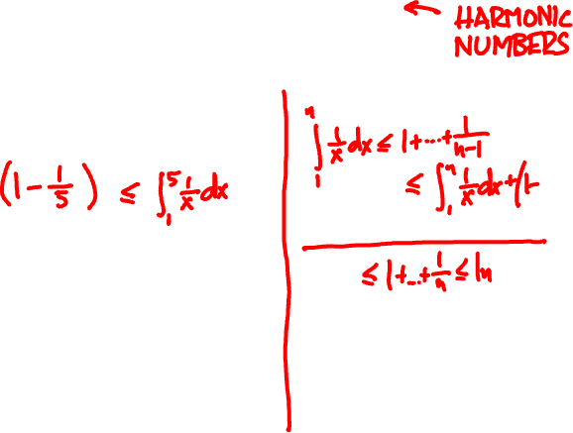

Slide 14
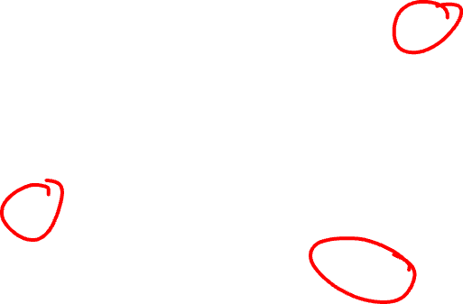
order of growth
13n⁴ + 2n² + 10n + 100
1² + 2² + … + n²
n²
2^{n}
2
n!
log(n² + 11) − √log n
√1 + √2 + … +√n
2^{n}
log n
n^{1.99} + 3n^{1.54}
1.99^{n}

Slide 15
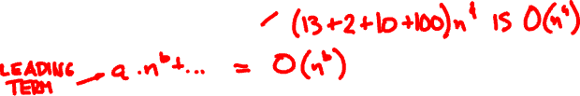
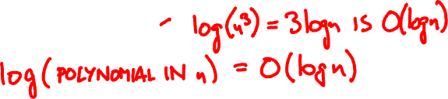
big O
f is O(g) if there is a constant C so that
f(n) < C∙g(n) for all sufficiently large n.
13n⁴ + 2n² + 10n + 100 =
log(n² + 11) − √log n =

Slide 16
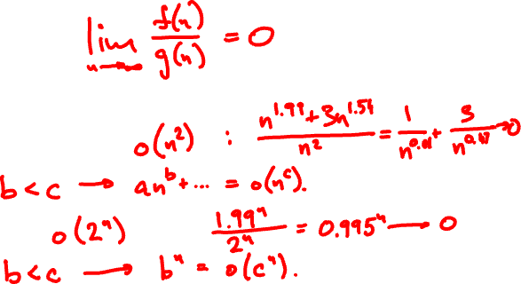
little o
f is o(g) if for every constant c and
all sufficiently large n, f(n) < c∙g(n)
n^{1.99} + 3n^{1.54} =
1.99^{n} =

Slide 17
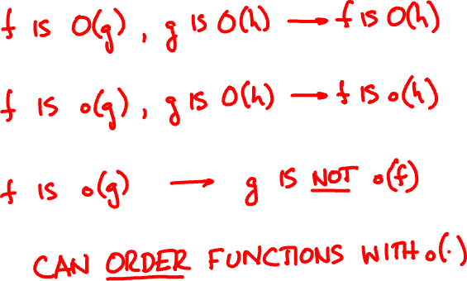
properties of O(∙) and o(∙)

Slide 18
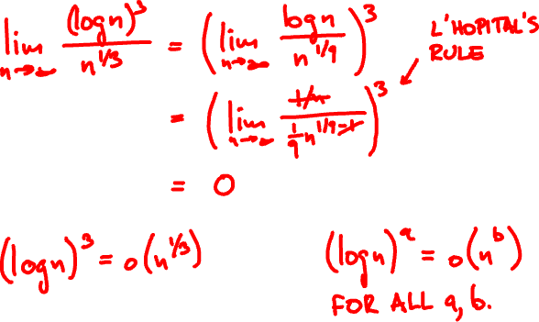
How do (log n)³ and n^{1/3} compare?

Slide 19
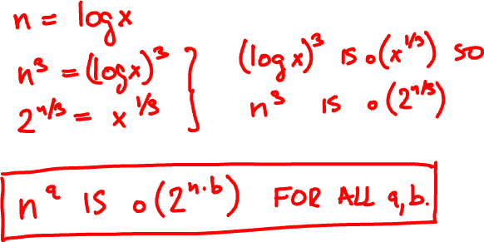
How do n³ and 2^{n/3} compare?

Slide 20
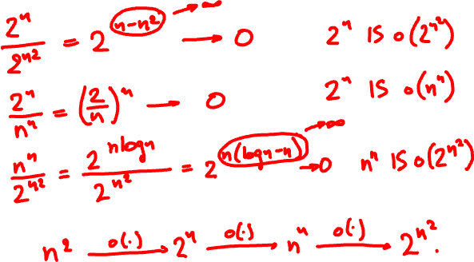
Order these functions asymptotically:
n^{n}
2^{n}
2^{n}
n²
2

Slide 21
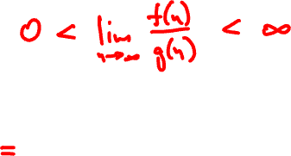
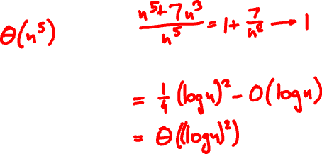
big Theta
f is Θ(g) if f is O(g) and g is O(f)
n⁵ + 7n³
(log(n^{1/2}))² − log(n⁴ + n²)

Slide 22
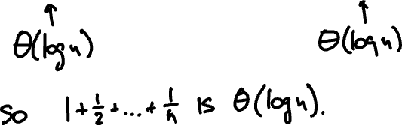
How fast does 1 + 1/2 + … + 1/n grow?

Slide 23
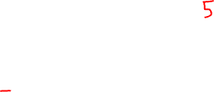
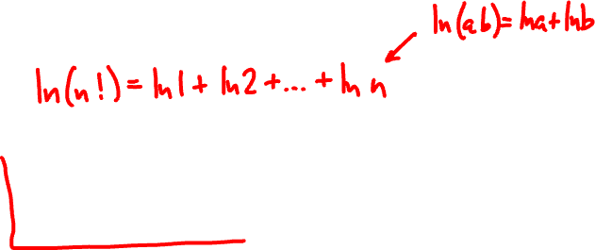
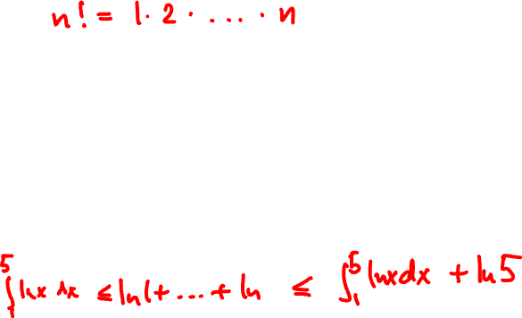
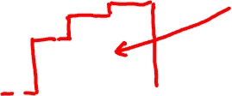
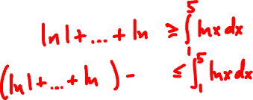
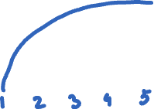
How fast does n! grow?

Slide 24

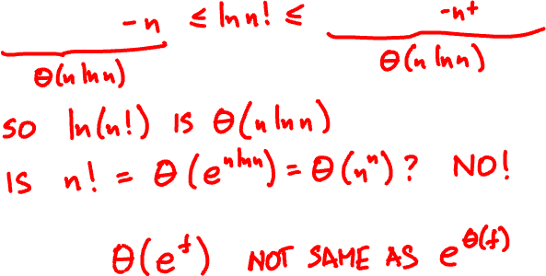

Slide 25
