Slide 1
7. RECURRENCES
CSI 2101: Discrete Structures
Andrej Bogdanov

Slide 2
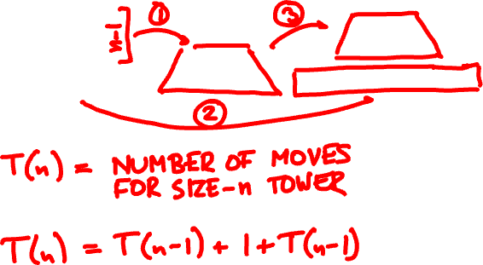

towers of Hanoi

Slide 3
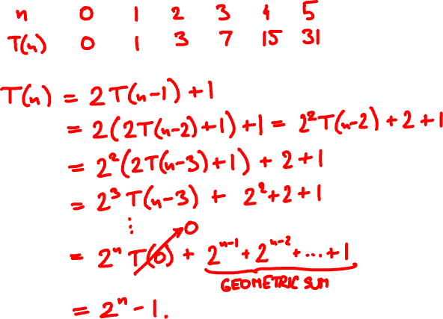
solving recurrences

Slide 4
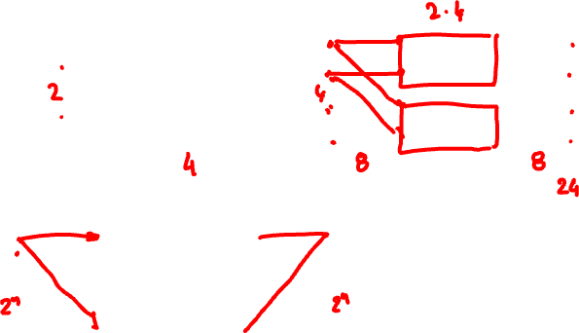
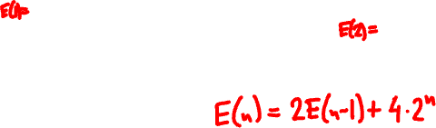
Beneš networks
B₁
B₂
B_{n-1}
B_{n-1}
B_{n}

Slide 5
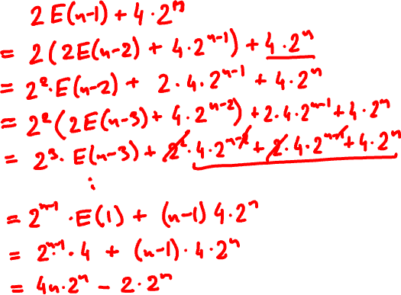

E(n) =

Slide 6
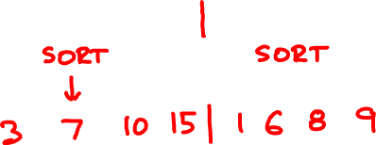
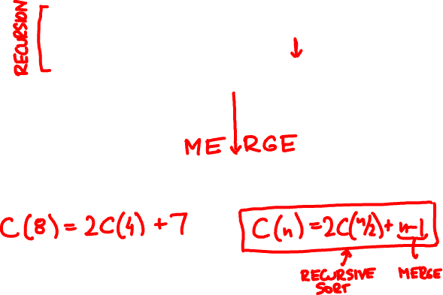
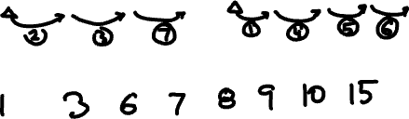
merge sort
10 7 15 3 6 8 1 9

Slide 7
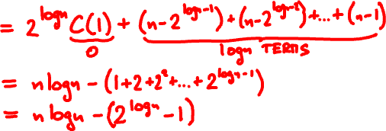
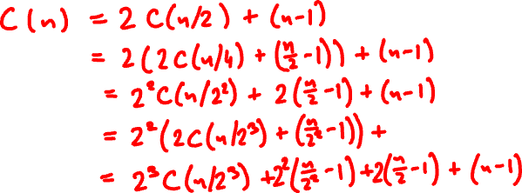




Slide 8
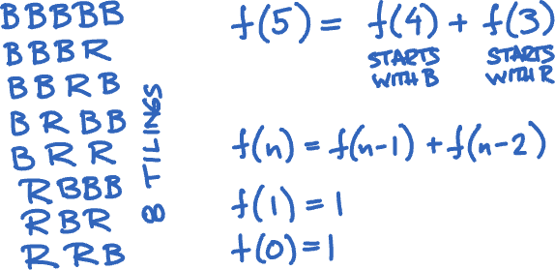
tilings

Slide 9
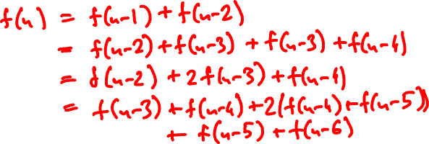
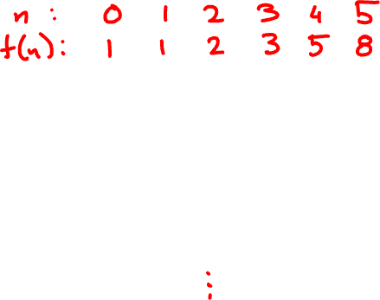

Slide 10
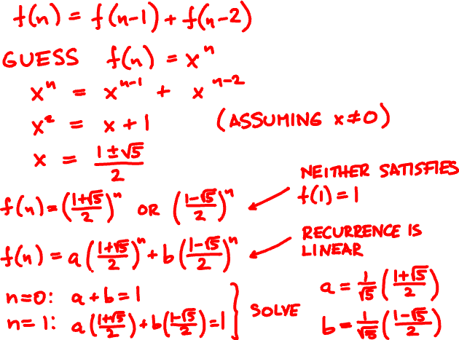

Slide 11
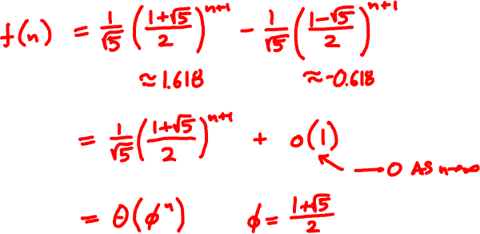

Slide 12
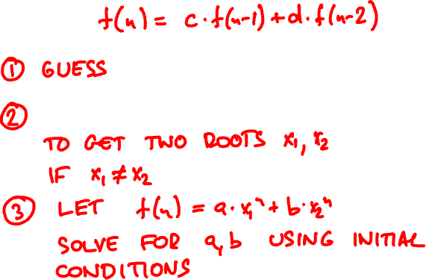


homogeneous linear recurrences

Slide 13


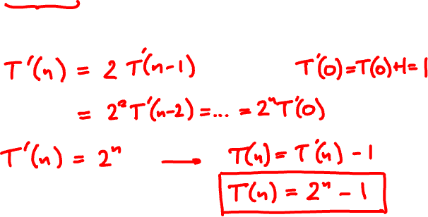
homogenization
T(n) = 2T(n – 1) + 1
T(0) = 0

Slide 14

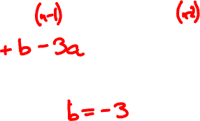
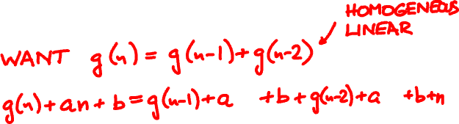
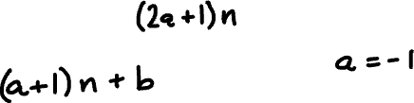
homogenization
f(n) = f(n – 1) + f(n – 2) + n

Slide 15
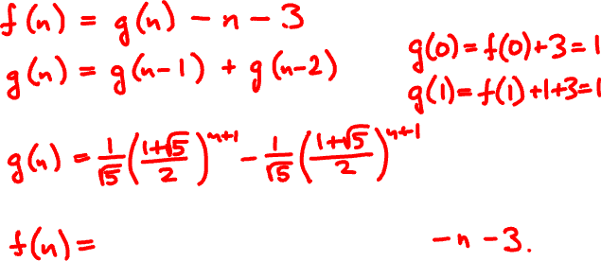

f(0) = -2
f(1) = -3
f(n) = f(n – 1) + f(n – 2) + n

Slide 16
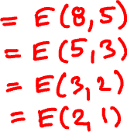
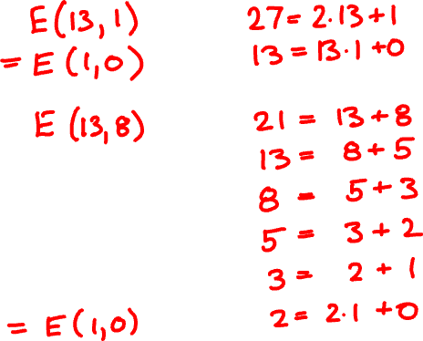
Euclid’s algorithm
E(27, 13) =
E(21, 13) =

Slide 17
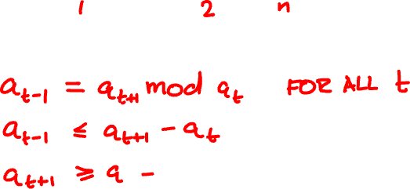
(a_{n+1}, a_{n}) → (a_{n}, a_{n-1}) → … → (a₁, a₀)

Slide 18


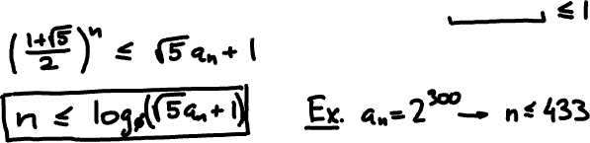
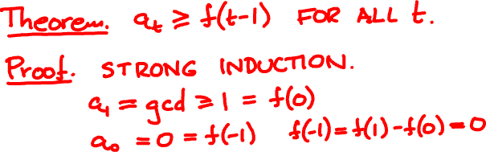
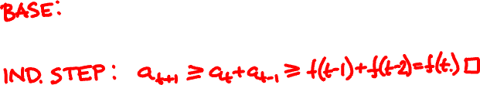

Slide 19
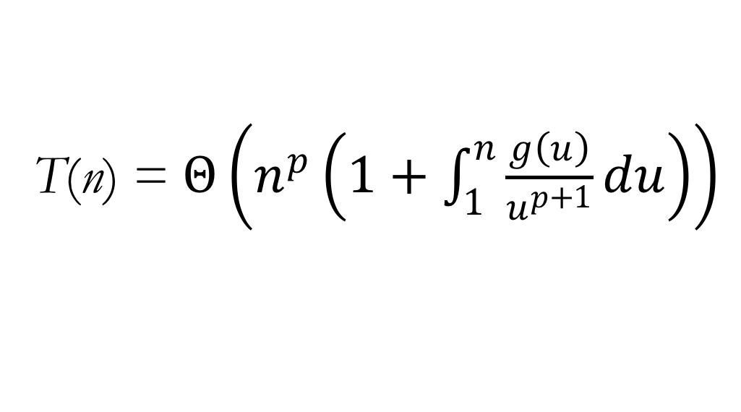
divide-and-conquer recurrences
T(n) = a₁T(b₁n) + … + a_{k}T(b_{k}n) + g(n)
solves to
T(n) = $Θ\left(n^{p}\left(1+\int_{1}^{n}{\frac{g\left(u\right)}{u^{p+1}}du}\right)\right)$
where p satisfies
a₁b₁^{p} + … + a_{k}b_{k}^{p} = 1
(assuming g is sufficiently nice)

Slide 20
C(n) = 2C(n/2) + n – 1

Slide 21
M(n) = 7M(n/2) + Θ(n²)

