Slide 1
9. CONNECTIVITY
DIRECTED GRAPHS
CSI 2101: Discrete Structures
Andrej Bogdanov

Slide 2

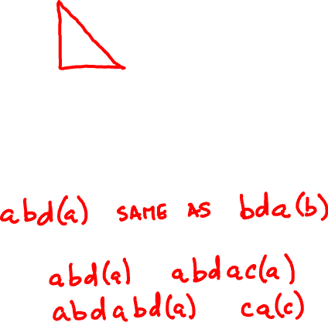
a
c
e
b
d
path:
cycle:
closed walk:

Slide 3
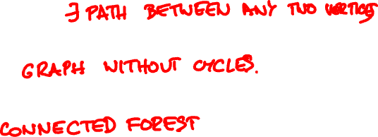
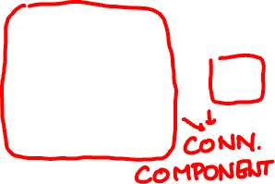
a
b
c
a
c
e
b
d
d
e
f
connected:
forest:
tree:

Slide 4
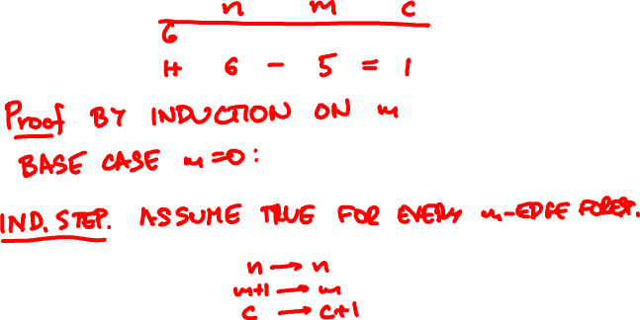
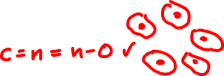


Theorem: A forest with n vertices and m edges has n – m connected components

Slide 5


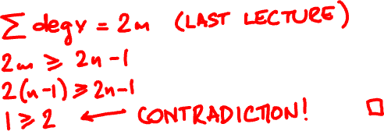
Corollary: A tree with n vertices has edges.
Corollary: Every nonempty tree has at least two leaves.

Slide 6



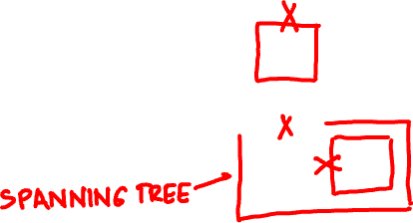
spanning tree

Slide 7
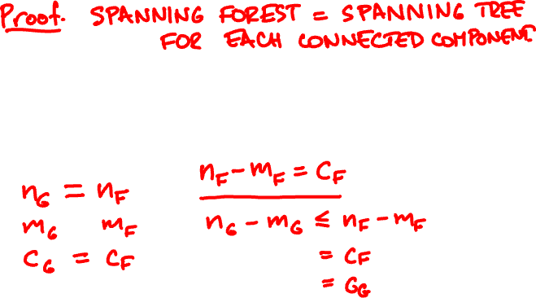
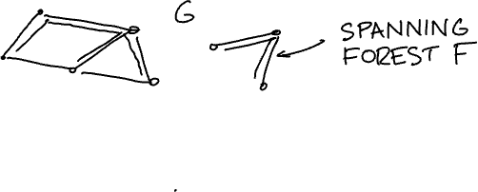
Corollary: A graph with n vertices and m edges has at least n – m connected components.

Slide 8
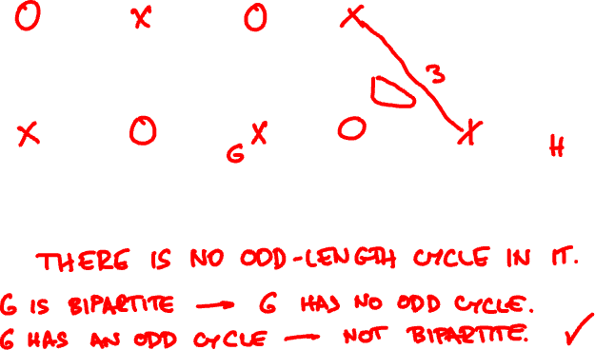
bipartite graphs
Theorem: A graph is bipartite if and only if

Slide 9

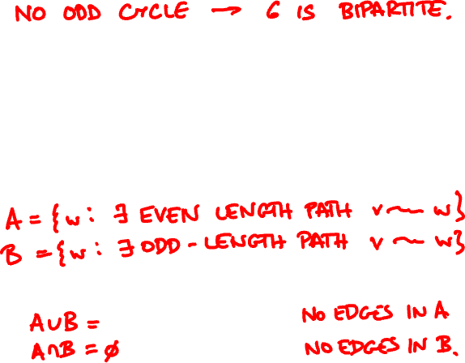
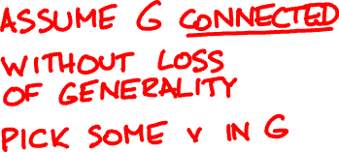
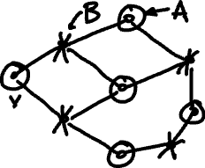


Slide 10


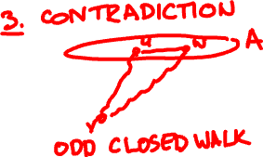




Slide 11
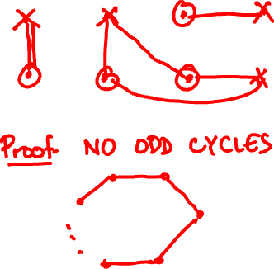
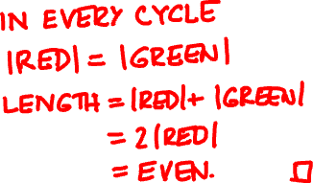
Corollary: A union of two matchings is bipartite.

Slide 12


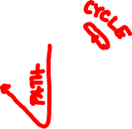
directed graphs
b
b
a
c
e
a
c
d
d
acyclic (DAG):

Slide 13

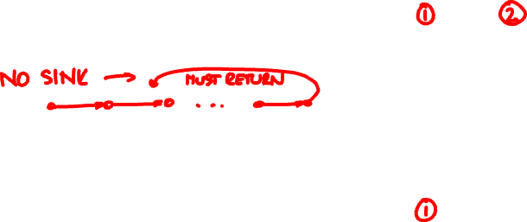

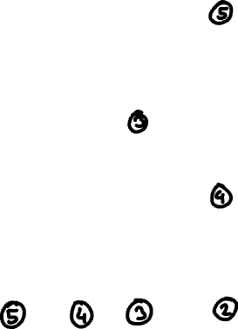
topological sort
b
Lemma: A DAG has
at least one sink.
a
c
e
d

Slide 14
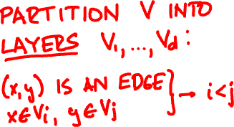
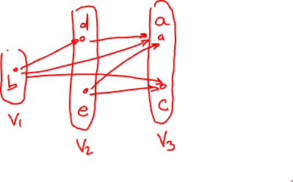
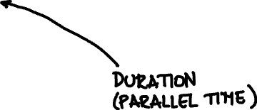
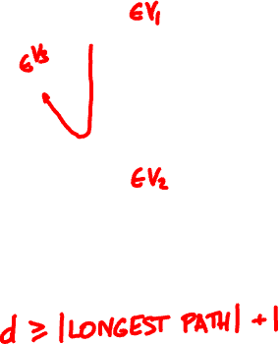
parallel scheduling
b
a
c
e
d

Slide 15

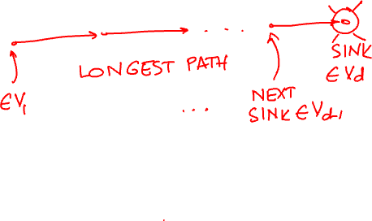


Slide 16
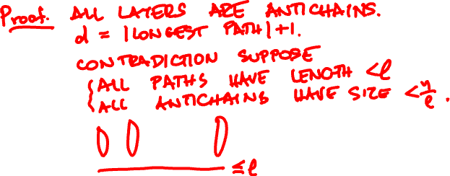


antichains
Theorem: A DAG on n vertices has a path of length ≥ l or an antichain of size ≥ n/l

Slide 17


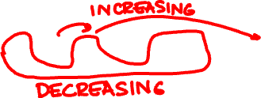
increasing/decreasing subsequences
8 4 5 2 3 0 1 9 6 7

Slide 18
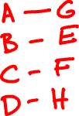
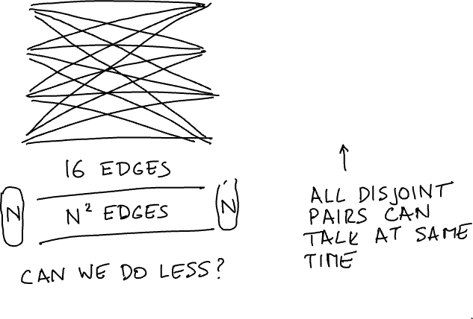
switching networks
A
E
B
F
C
G
D
H

Slide 19
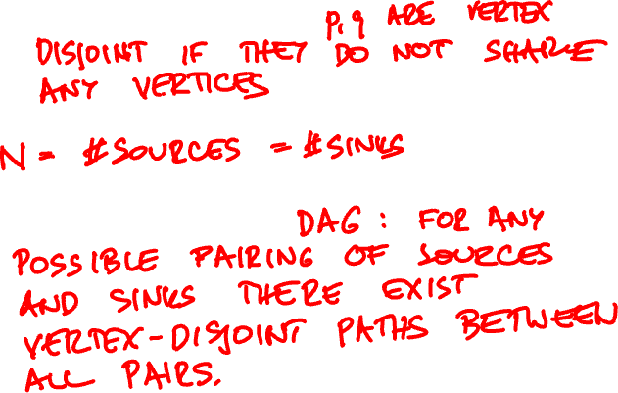
vertex-disjoint paths:
switching network:

Slide 20
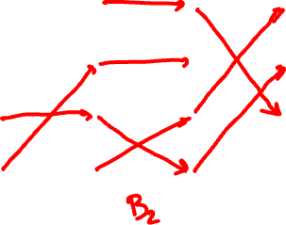

A
E
B
F
C
G
D
H

Slide 21

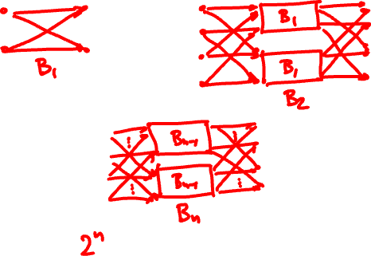
the Beneš network

Slide 22
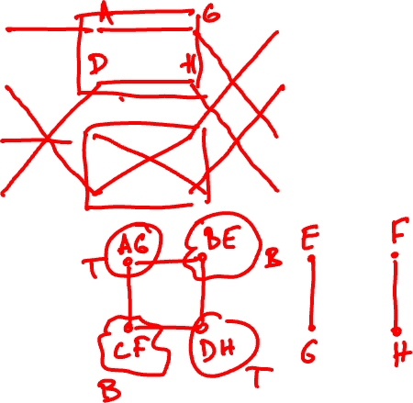
A
E
B
F
C
G
D
H

Slide 23
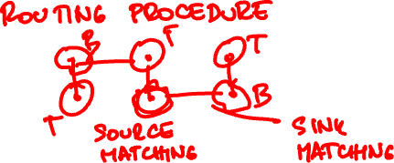
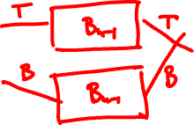
Theorem: For every n, B_{n} is a switching network.

Slide 24
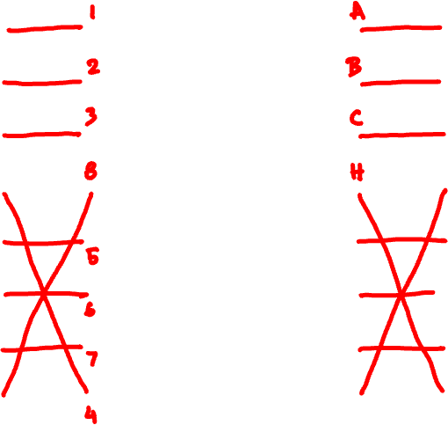
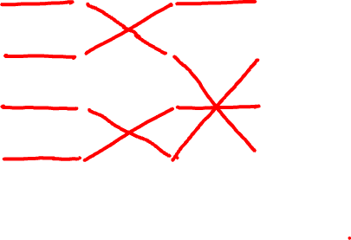
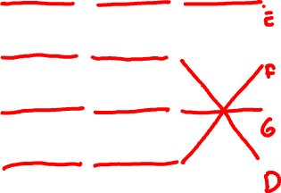
1
A
2
B
3
C
4
D
5
E
6
F
7
G
8
H

Slide 25


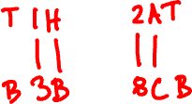
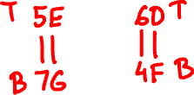
1H
2A
3B
4F
5E
6D
7G
8C

