Slide 1
10. CIRCUITS
CSI 2101: Discrete Structures
Andrej Bogdanov

Slide 2
$y\left(x_{1},x_{2},x_{3},x_{4},x_{5}\right)=x_{1}x_{2}+x_{1}x_{3}+$ $x_{1}x_{4}+ x_{1}x_{5}+ x_{2}x_{3}$
$+ x_{2}x_{4}+ x_{2}x_{5}+ x_{3}x_{4}+ x_{3}x_{5}+ x_{4}x_{5}$
$$y$$
$$x_{1}$$
$$x_{2}$$
$$x_{3}$$
$$x_{4}$$
$$x_{5}$$

Slide 3
circuits

Slide 4
$y\left(x_{1},x_{2},x_{3},x_{4},x_{5}\right)=x_{1}x_{2}+x_{1}x_{3}+$ $x_{1}x_{4}+ x_{1}x_{5}+ x_{2}x_{3}$
$+ x_{2}x_{4}+ x_{2}x_{5}+ x_{3}x_{4}+ x_{3}x_{5}+ x_{4}x_{5}$
$$y$$
$$x_{1}$$
$$x_{2}$$
$$x_{3}$$
$$x_{4}$$
$$x_{5}$$

Slide 5
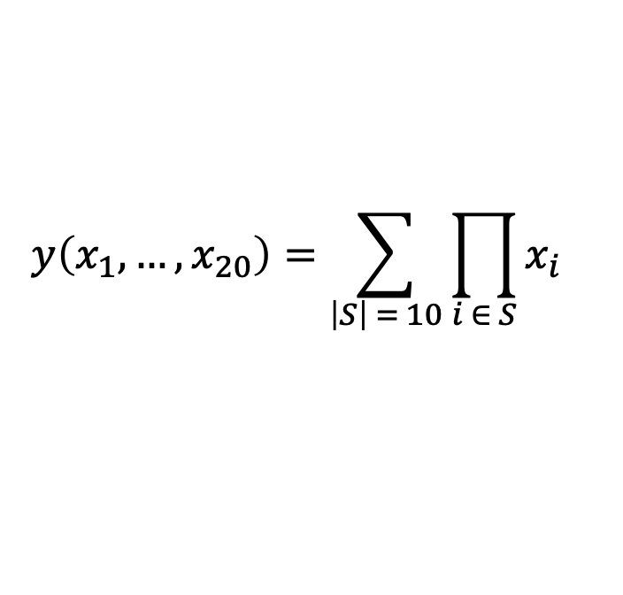
$$y\left(x_{1},…,x_{20}\right)=\sum_{\left|S\right| = 10}{\prod_{i ∈ S}{x_{i}}}$$
$=x_{1}x_{2}…{x_{9}x}_{10}+x_{1}x_{2}…{x_{9}x}_{11}+$ $x_{11}x_{12}…x_{20}$

Slide 6
parallel time

Slide 7
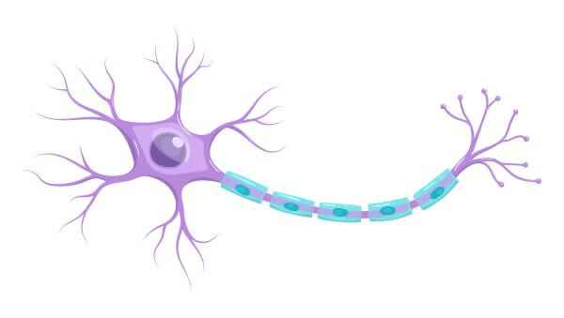
perceptrons

Slide 8
$$x_{1}$$
$$x_{2}$$
$$x_{3}$$

Slide 9
training

Slide 10
gradient descent

Slide 11
derivatives in circuits
$$u_{1}$$
$$u_{3}$$
$$x_{1}$$
+
+
$$x_{2}$$
×
×
$$y$$
$$u_{2}$$

Slide 12
$$u_{1}$$
$$u_{3}$$
$$x_{1}$$
+
$$x_{2}$$
×
×
$$y$$
$$u_{2}$$

Slide 13
$$u_{1}$$
$$u_{3}$$
+
×
×
$$y$$
$$u_{2}$$

Slide 14
chain rule and backpropagation

