Slide 1
5. Expectation, Variance,
Joint PMFs
ENGG 2760A / ESTR 2018: Probability for Engineers

Slide 2
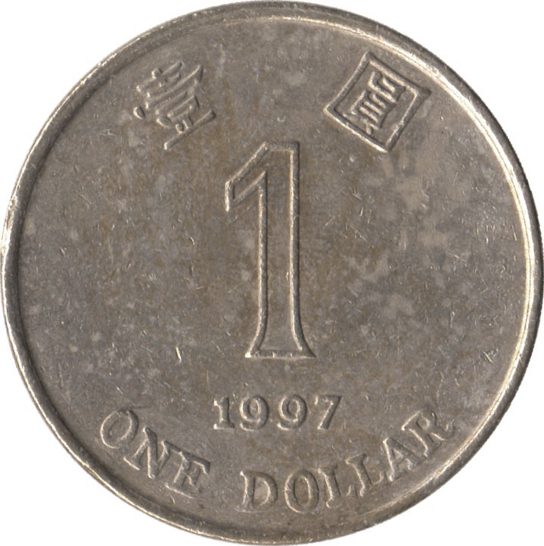

Expected value
The expected value (expectation) of a random variable X with p.m.f. p is
E[X] = ∑_{x} x p(x)
Example
N = number of Hs

Slide 3
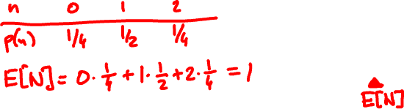
Expected value
Example
N = number of Hs
The expectation is the average value the random variable takes when experiment is done many times

Slide 4
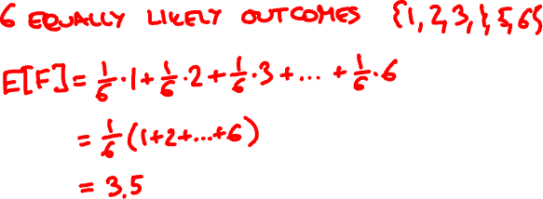

F = face value of fair 6-sided die

Slide 5


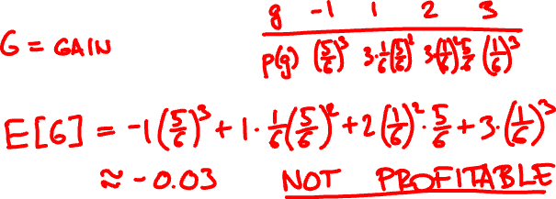
If appears k times, you win $k.
If it doesn’t appear, you lose $1.

Slide 6



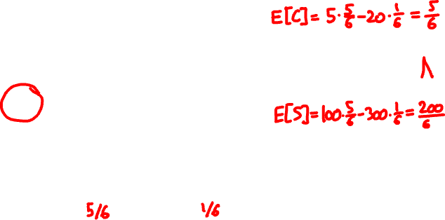
Utility
Should I go to tutorial?
not called
called
+5
-20
Come
+100
-300
Skip
F
25/30
5/30

Slide 7


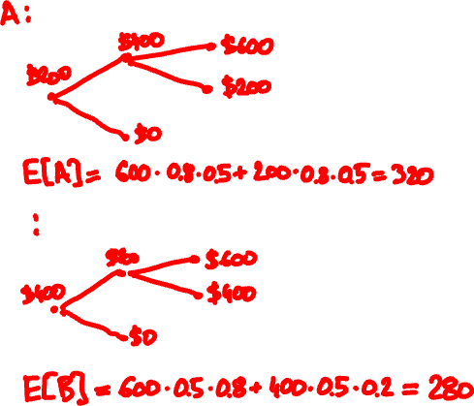
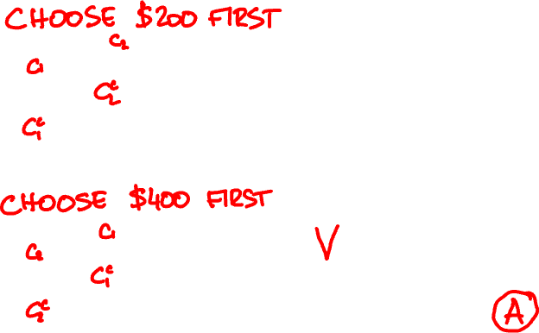
80%
50%

Slide 8
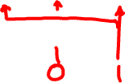
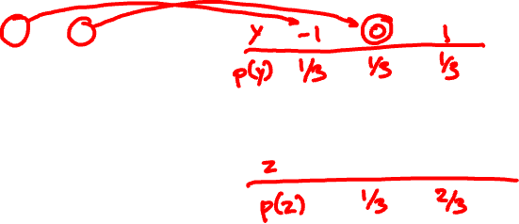
Functions of random variables
PMF of X:
PMF of X – 1?
x
0 1 2
p(x)
1/3 1/3 1/3
PMF of (X – 1)²?
If X is a random variable with p.m.f. p_{X},
then Y = f(X) is a random variable with p.m.f.
p_{Y}(y) = ∑_{x: f(x) = y} p_{X}(x).

Slide 9
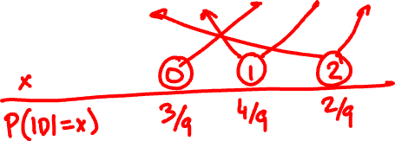

D is the difference of two 3-sided dice rolls.
Calculate the PMF of |D|.

Slide 10
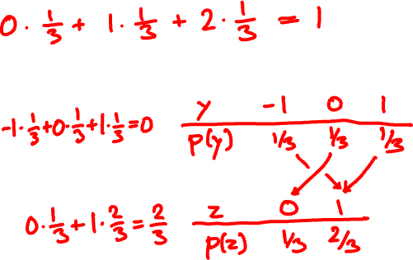
Expectation of a function
x
0 1 2
PMF of X:
p(x)
1/3 1/3 1/3
E[X] =
E[X – 1]=
E[(X – 1)²]=

Slide 11
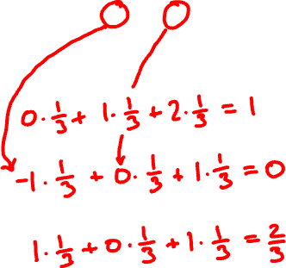
Expectation of a function, again
x
0 1 2
p.m.f. of X:
p(x)
1/3 1/3 1/3
E[X] =
E[X – 1]=
E[(X – 1)²]=
E[f(X)] = ∑_{x} f(x) p(x)

Slide 12
1km
☀️
⛈
🚶🏻‍♀️
🚍
60%
40%
5km/h
30km/h

Slide 13
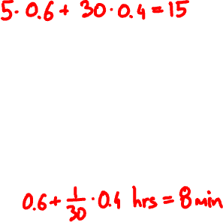
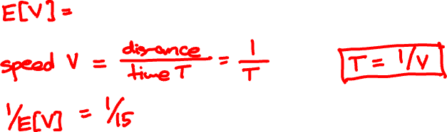






Slide 14
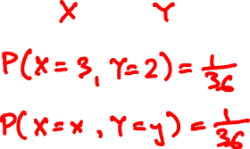
Joint probability mass function
The joint PMF of random variables X, Y is the bivariate function
p(x, y) = P(X = x, Y = y)
Example

Slide 15
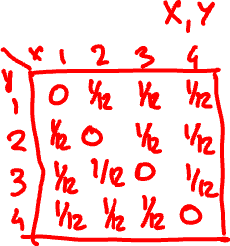
There is a bag with 4 cards:
1
2
3
4
You draw two without replacement. What is the joint PMF of the face values?

Slide 16
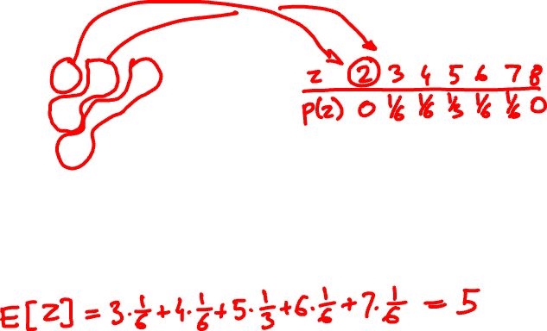
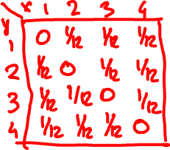
What is the PMF of the sum?
What is the expected value?

Slide 17
PMF and expectation of a function
Z = f(X, Y) has PMF
p_{Z}(z) = ∑_{x, y: f(x, y) = z} p_{XY}(x, y)
and expected value
E[Z] = ∑_{x, y} f(x, y) p_{XY}(x, y)

Slide 18
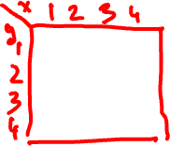
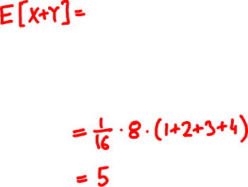

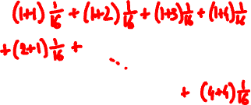
What if the cards are drawn with replacement?

Slide 19
Marginal probabilities
X
1
2
3
4
Y
0 | 1/12 | 1/12 | 1/12
1/12 | 0 | 1/12 | 1/12
1/12 | 1/12 | 0 | 1/12
1/12 | 1/12 | 1/12 | 0
1/4
1/4
1/4
1/4
1
2
P(Y = y) = ∑_{x} P(X = x, Y = y)
3
4
1/4 | 1/4 | 1/4 | 1/4
1
P(X = x) = ∑_{y} P(X = x, Y = y)

Slide 20
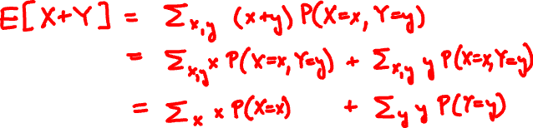

Linearity of expectation
For every two random variables X and Y
E[X + Y] = E[X] + E[Y]

Slide 21
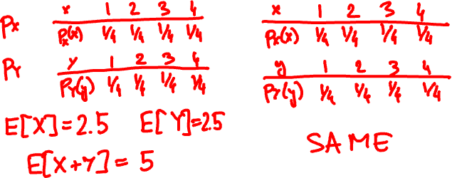
1
2
3
4
E[X + Y]
without replacement
with replacement

Slide 22
The indicator (Bernoulli) random variable
Perform a trial that succeeds with probability p and fails with probability 1 – p.
x
0 1
p(x)
p(x)
1 – p p
p = 0.5
If X is Indicator(p) then
E[X] = p
p(x)
p = 0.4

Slide 23
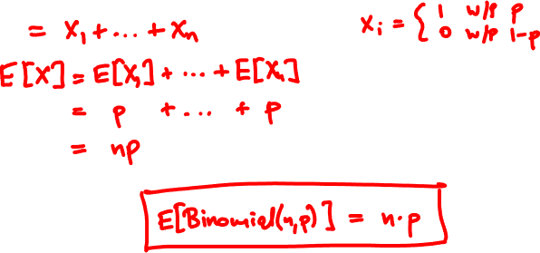
Mean of the Binomial
Binomial(n, p): Perform n independent trials, each of which succeeds with probability p.
X = number of successes

Slide 24
Binomial(10, 0.5)
Binomial(50, 0.5)
Binomial(10, 0.3)
Binomial(50, 0.3)

Slide 25
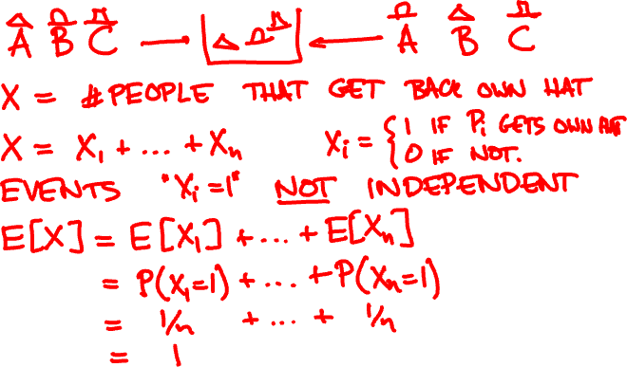
n people throw their hats in a box and each picks one out at random. On average, how many get back their hat?

Slide 26
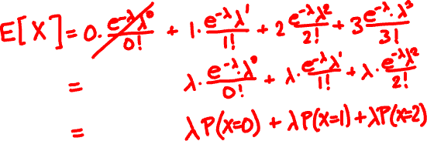
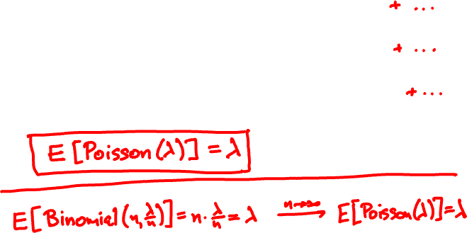
Mean of Poisson(λ)
p(k) = e^{-λ} λ^{k}/k!
k = 0, 1, 2, 3, …

Slide 27
Investments
You have three investment choices:
A: put $25 in one stock
B: put $½ in each of 50 unrelated stocks
C: keep your money in the bank
Which do you prefer?

Slide 28
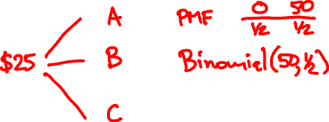

Investments
Probability model
doubles in value with probability ½
Each stock
loses all value with probability ½
Different stocks perform independently

Slide 29
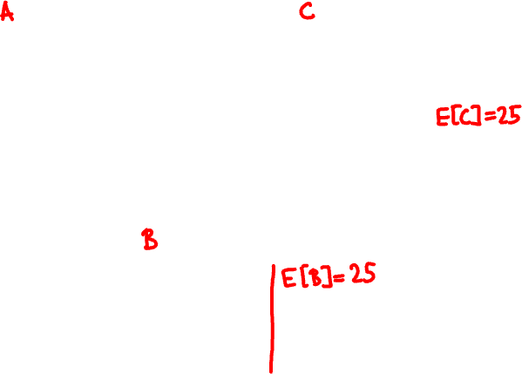
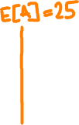

Slide 30
Variance and standard deviation
Let μ = E[X] be the expected value of X.
The variance of X is
Var[X] = E[(X – μ)²]
The standard deviation of X is σ = √Var[X]
It measures how close X and μ are typically.

Slide 31
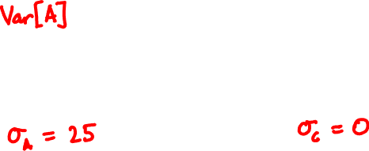
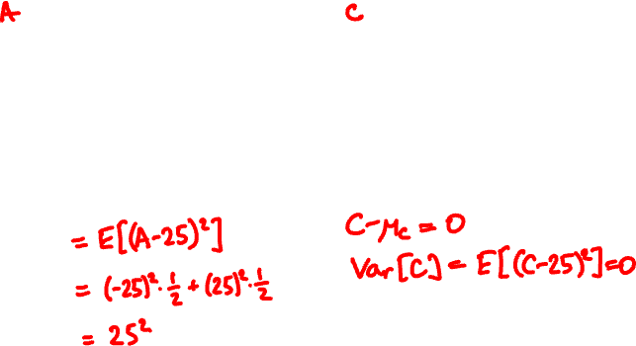
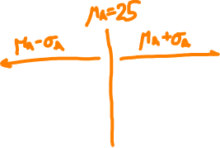

Slide 32
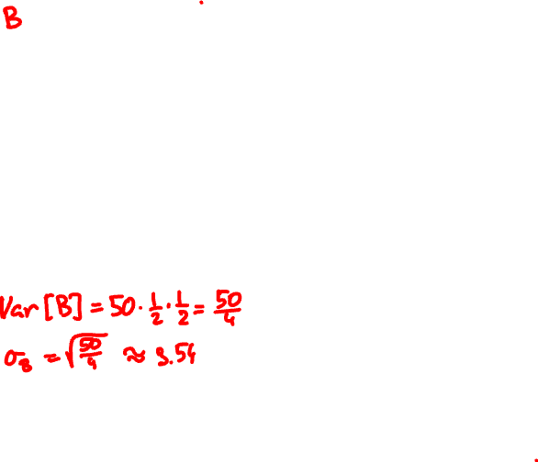
X
(X – μ)/σ
21
33
26
22
28
24
23
24
20
23
26
22
33
28
22
-1.13
2.26
0.28
-0.85
0.85
-0.28
-0.57
-0.28
-1.41
-0.57
0.28
-0.85
2.26
0.85
-0.85
Var[Binomial(n, p)] = np(1 – p)

Slide 33
Another formula for variance

Slide 35
E[X] = ?
Var[X] = ?

