Slide 1
8. Multiple Continuous
Random Variables
ENGG 2760A / ESTR 2018: Probability for Engineers

Slide 2

One random variable review
PMF f(x)
PDF f(x)
P(X ≤ a)
∑_{x ≤ a} f(x)
∫_{x ≤ a} f(x)dx
E[X]
∑_{x} x f(x)
∫_{x} x f(x)dx
Uniform
Exponential(λ)
Normal

Slide 3
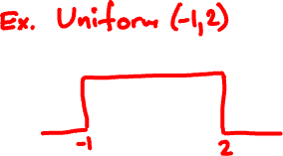
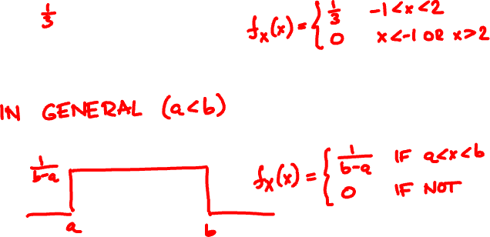
The Uniform(a, b) random variable

Slide 4
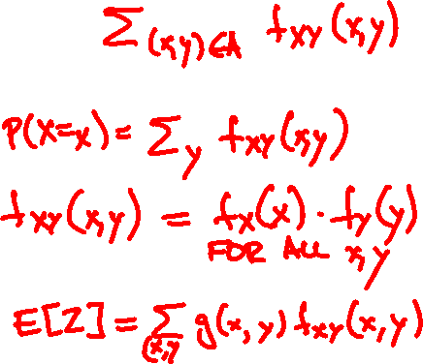
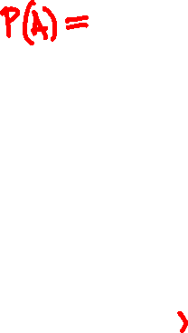
Discrete two variables review
joint PMF f_{XY}(x, y) = P(X = x, Y = y)
Probability of A
Marginals
Independence
Expectation of Z = g(X, Y)

Slide 5
Continuous random variables
A pair of continuous random variables X, Y can be specified either by their joint CDF
F_{XY}(x, y) = P(X ≤ x, Y ≤ y)
or by their joint PDF
∂
∂
f_{XY}(x, y)
=
F_{XY}(x, y)
∂x
∂y
P(x < X ≤ x + ε, y < Y ≤ y + δ)
=
lim
ε, δ → 0
εδ

Slide 6

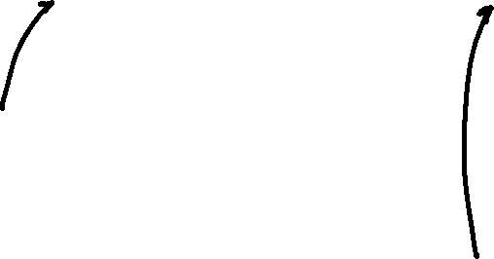
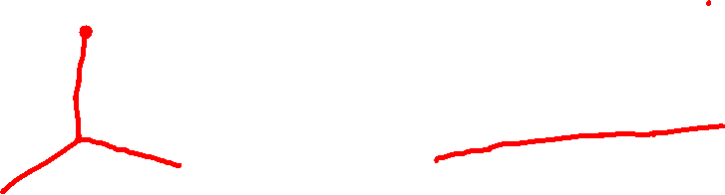
Rain drops at a rate of 1 drop/sec. Let X and Y be the arrival times of the first and second raindrop.
X
Y
F(x, y) = P(X ≤ x, Y ≤ y)
f(x, y)
=
∂
∂
F(x, y)
∂x
∂y

Slide 7
Continuous marginals
Joint CDF F_{XY}(x, y) = P(X ≤ x, Y ≤ y)
Marginal CDF:
F_{X}(x) = P(X ≤ x)
P(X ≤ x)
Exponential(1)

Slide 8

the continuous cheat sheet
X, Y continuous with joint p.d.f. f_{XY}(x, y)
Probability of A
P(A) = ∫∫_{A} f_{XY} (x, y) dxdy
Marginals
∞
f_{X}(x) = ∫_{-∞} f_{XY}(x, y) dy
Independence
f_{XY}(x, y) = f_{X}(x) f_{Y}(y) for all x, y
Expectation of Z = g(X, Y)
E[Z] = ∫∫ g(x, y) f_{XY}(x, y) dxdy

Slide 9
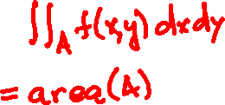

Independent uniform random variables
Let X, Y be independent Uniform(0, 1).
1
if 0 < x, y < 1
f_{XY}(x, y) = f_{X}(x) f_{Y}(y) =
0
if not
f_{XY}(x, y)
P(A) =

Slide 10
Romeo and Juliet have a date between 9 and 10.
The first to arrive will wait for 15 minutes and leave if the other isn’t there.
What is the probability they meet?

Slide 11
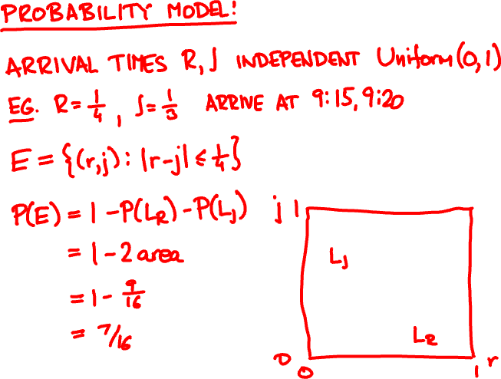
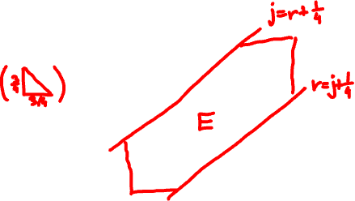

Slide 12
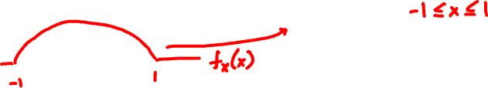
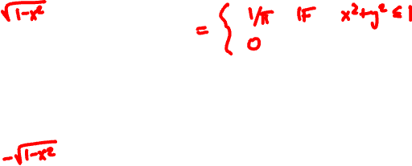

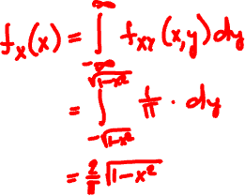

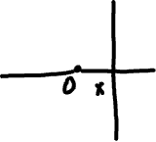
Joint PDF of X, Y is uniform over unit circle.
What are the marginals?

Slide 13

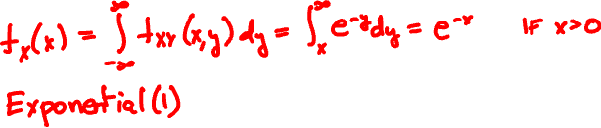
Joint PDF of X, Y is
e^{-y} if 0 < x < y
f_{XY}(x, y) =
0 if not
What is f_{Y}(y)?
What is f_{X}(x)?

Slide 14
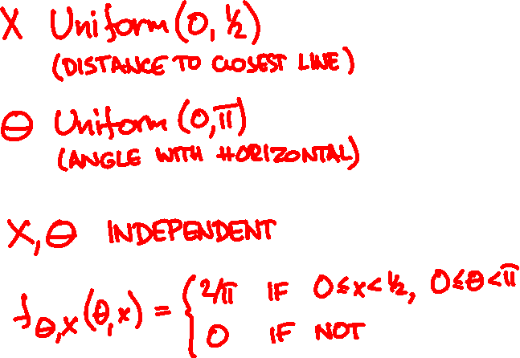
Probability model
X
Θ
1

Slide 15
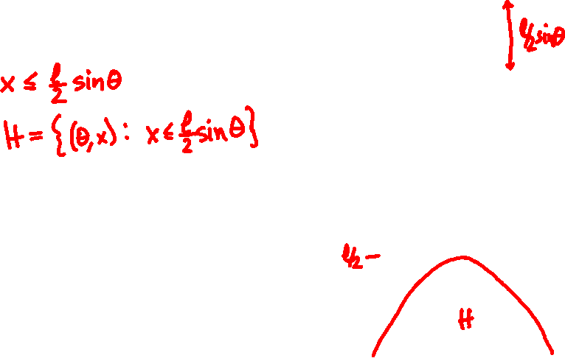
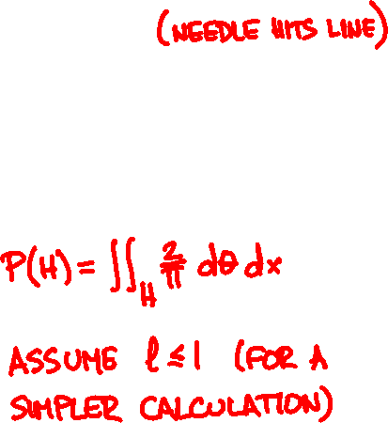
Buffon’s needle
l/2
Event H :
X
Θ
1
½
x
0
0
θ
π

Slide 16
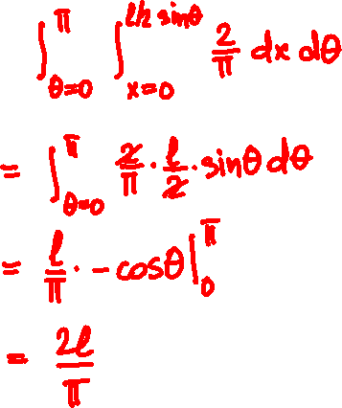
Buffon’s needle
Assume l ≤ 1 (short needle)
P(H) =

Slide 17
Conditioning
Y
discrete
continuous
X
P(X = x, Y = y)
discrete
P(X = x | Y = y) =
P(Y = y)
continuous

Slide 18
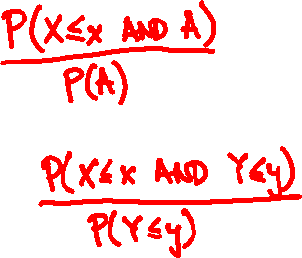
Conditioning
Y
discrete
continuous
X
discrete
P(X ≤ x | A) =
P(X ≤ x | Y ≤ y) =
continuous

Slide 19
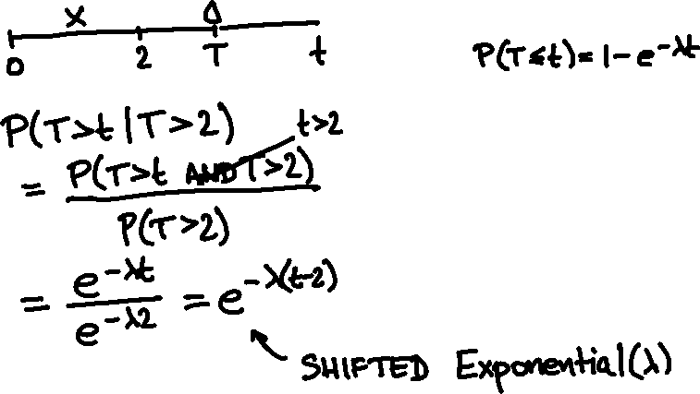
Rain drops at a rate λ = 1/sec.
You walk for 2 sec, no drop yet.
What is the arrival time of first drop?
Exponential(λ) CDF

Slide 20
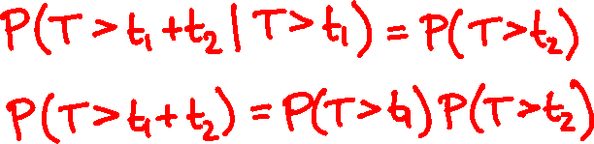
T
Memorylessness of Exponential(λ):

Slide 21
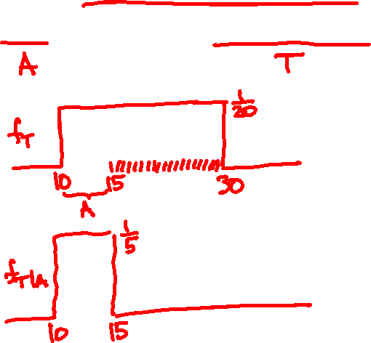
Alice arrives 8.10 - 8.30.
2760A
Given she caught the first bus, what is her arrival time?
8.15 AM
8.30 AM

Slide 22
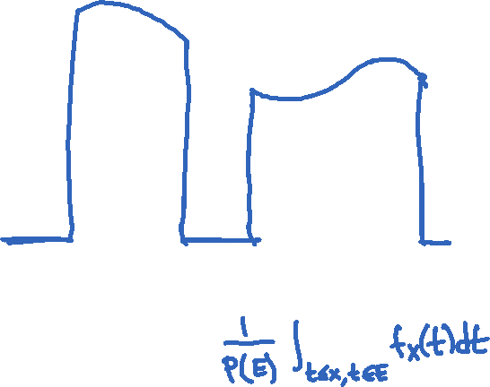
Conditioning a continuous RV on an event
f_{X}(x)
PDF:
f_{X | E} (x) =
when x ∈ E
P(E)
f_{X}(x)
x
E
CDF:
P(X ≤ x | E) =

Slide 23
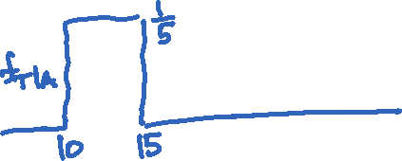
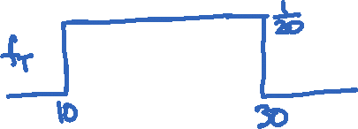
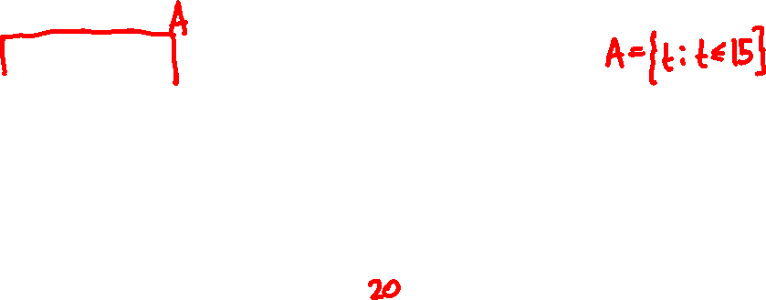

Arrival time is Uniform(10, 30)
2760A
Conditional arrival time PDF:
8.15 AM
8.30 AM

Slide 24
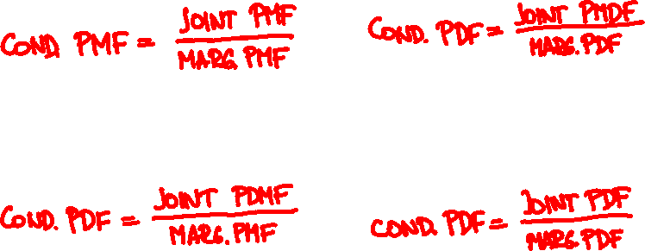
Conditioning
X
discrete
continuous
Y
discrete
f_{XY}(x, y)
f_{Y|X}(y | x) =
f_{X}(x)
continuous

Slide 25
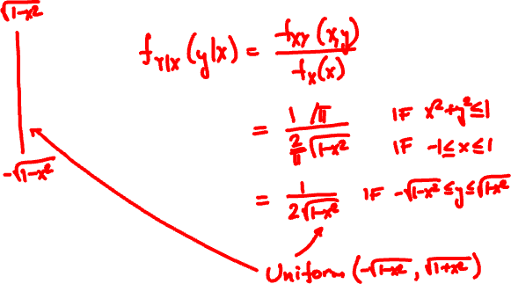
Joint PDF of X, Y is uniform over unit circle.
What is the conditional PDF f_{Y|X}(y|x)?

Slide 26
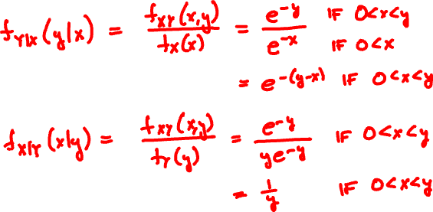
Joint PDF of X, Y is
e^{-y} if 0 < x < y
f_{XY}(x, y) =
0 if not
What are the conditional PDFs?

Slide 27
Total probability theorem:
f_{X}(x) = ∑_{y} f_{X|Y}(x | y) f_{Y}(y)
Y discrete
f_{X}(x) = ∫ f_{X|Y}(x | y) f_{Y}(y) dy
Y continuous
Total expectation theorem:
E[X] = ∑_{y} E[X | Y = y] f_{Y}(y)
Y discrete
E[X] = ∫ E[X | Y = y] f_{Y}(y) dy
Y continuous

Slide 28
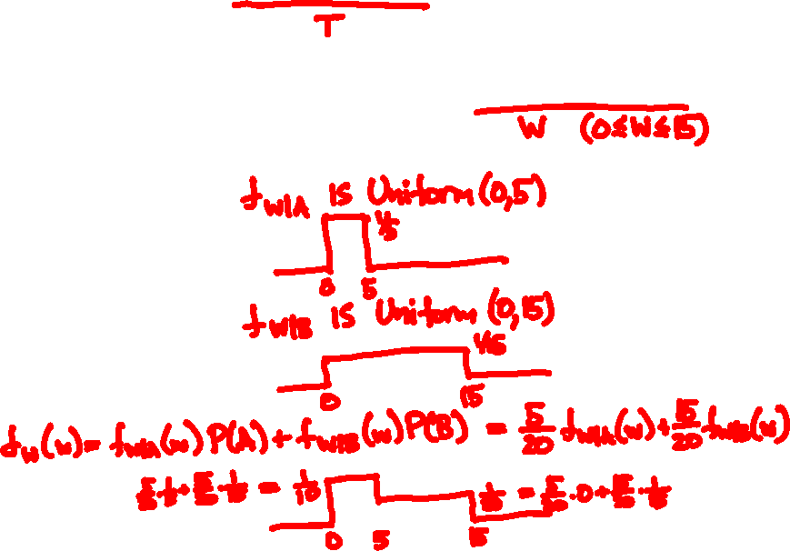
Arrival time is Uniform(10, 30)
2760A
Unconditional waiting time PDF:
8.15 AM
8.30 AM

Slide 29
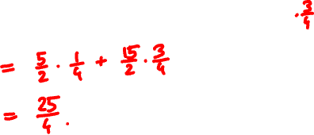

Arrival time is Uniform(10, 30)
2760A
Expected waiting time:
8.15 AM
8.30 AM

Slide 30
Independent Normals
X, Y are Normal

Slide 31
Continuous Bayes’ rule
f_{X|Y}(x | y) f_{Y}(y)
f_{Y | X}(y | x) =
f_{X}(x)

Slide 32


X = 1 or -1
Y = X + N
P(X = 1 | Y = y) =

