Slide 1
11. Chebyshev’s Inequality
The Central Limit Theorem
ENGG 2760A / ESTR 2018: Probability for Engineers

Slide 2
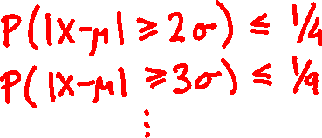
Chebyshev’s inequality
For every random variable X and every t:
P(|X – μ| ≥ tσ) ≤ 1 / t².
where μ = E[X], σ = √Var[X].

Slide 3
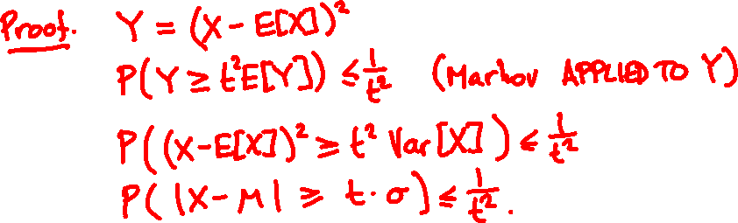
Chebyshev’s inequality
For every random variable X and every t:
P(|X – μ| ≥ tσ) ≤ 1 / t².
where μ = E[X], σ = √Var[X].

Slide 4
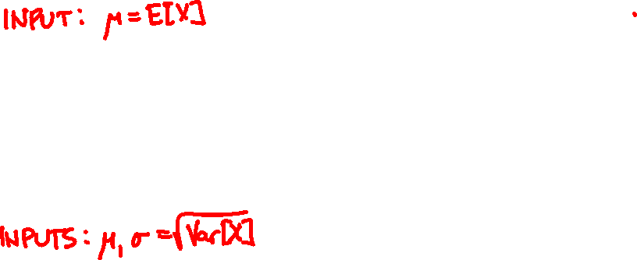

μ
a
Markov’s inequality:
P( X ≥ a ) ≤ μ / a.
p.m.f. / p.d.f. of X
0
μ – tσ
μ
μ + tσ
Chebyshev’s inequality:
P(|X – μ| ≥ tσ ) ≤ 1 / t².
σ
p.m.f. / p.d.f. of X

Slide 5
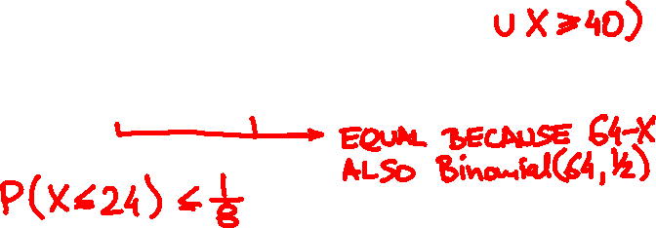
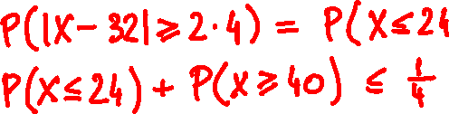
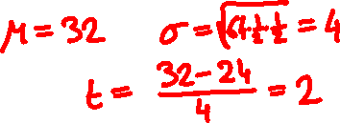
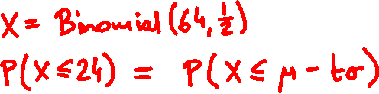
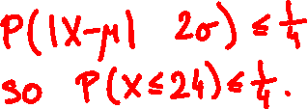
Probability of ≤ 24 heads in 64 coin flips?
Probability of ≤ 24 or ≥ 40 heads?

Slide 6
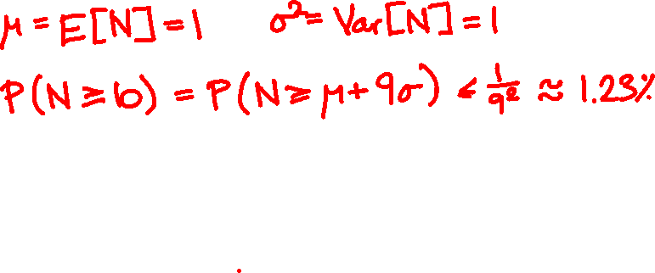
100 people throw their hats in the air. What is the probability at least 10 people get their hat back?

Slide 7
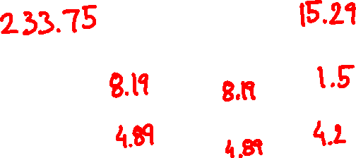
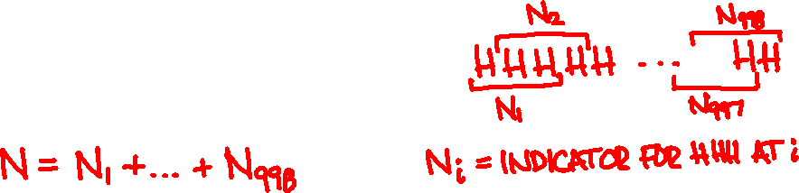
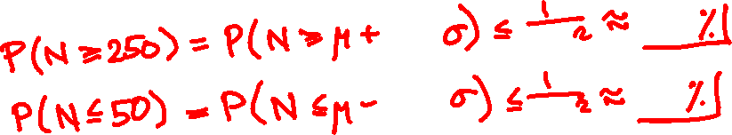
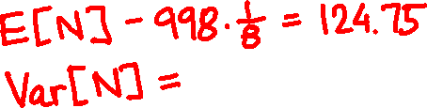

I toss a coin 1000 times. What is the probability I get 3 consecutive heads
(a) at least 250 times
(b) at most 50 times

Slide 8
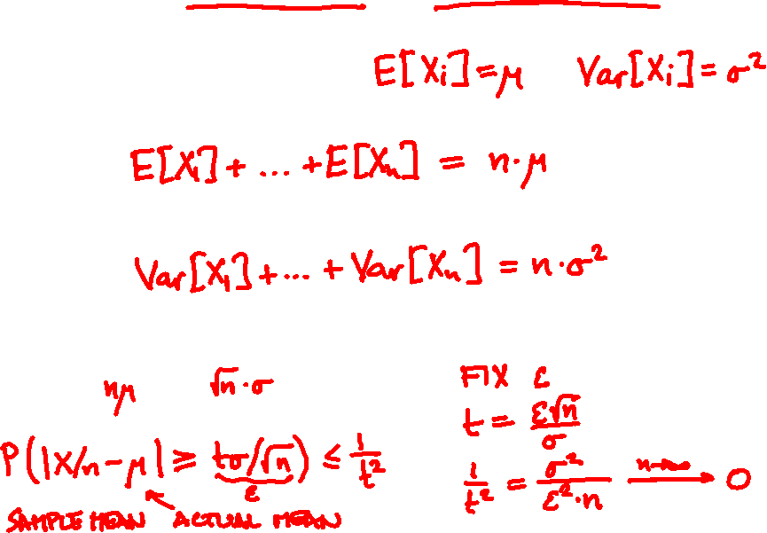
X₁,…, X_{n} are independent with same PMF/PDF
X = X₁ + … + X_{n}
E[X] =
Var[X] =
P(|X – | ≥ t ) ≤ 1/t²

Slide 9
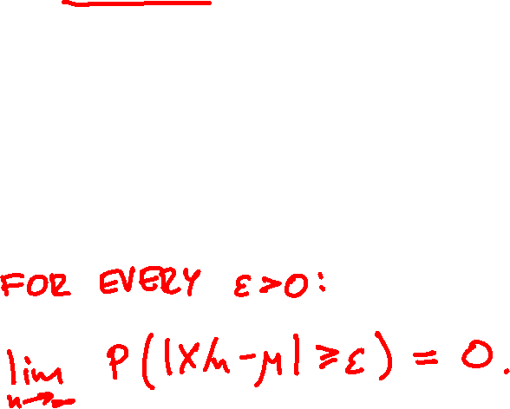
The weak law of large numbers
X₁,…, X_{n} are independent with same PMF/PDF
μ = E[X_{i}] Var[X_{i}] < ∞
X = X₁ + … + X_{n}

Slide 10
X₁, …, X_{n} independent Indicator(1/2)
X₁ + … + X_{n}
n
n

Slide 11
The strong law of large numbers
X₁,…, X_{n} are independent with same PMF / PDF
μ = E[X_{i}], X = X₁ + … + X_{n}
If E[X_{i}⁴] is finite then
P(lim_{n → ∞} X/n = μ) = 1

Slide 12
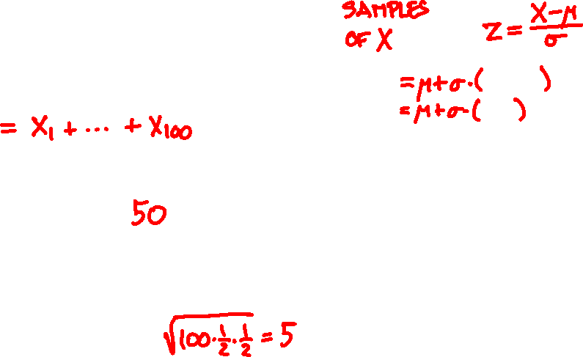
X = Binomial(100, 1/2)
52
45
48
49
43
48
37
49
48
49
50
44
44
+0.4
-1
-0.4
-0.2
-1.4
-0.4
-2.6
-0.2
-0.4
+0.2
+0
-1.2
-1.2
μ = E[X] =
σ = √Var[X] =

Slide 13
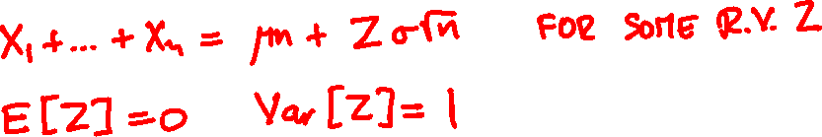
X₁,…, X_{n} are independent with same PMF/PDF
X₁ + … + X_{n} ≈ μn
with high probability
Chebyshev’s inequality
P(|X₁ + … + X_{n} – μn| ≥ tσ √n ) ≤ 1 / t².

Slide 14
X = X₁ + … + X_{n}
X_{i} independent Indicator(1/2)
n = 6
n = 40

Slide 15
X = X₁ + … + X_{n}
X_{i} independent Poisson(1)
n = 3
n = 20

Slide 16
X = X₁ + … + X_{n}
X_{i} independent Uniform(0, 1)
n = 2
n = 10

Slide 17
f(t) = (2π)^{-½} e^{-t /2}
²
t

Slide 18
The central limit theorem
X₁,…, X_{n} are independent with same PMF/PDF
(Var[X_{i}] > 0)
X = X₁ + … + X_{n}
For every z (positive or negative):
lim P(X ≤ E[X] + z√Var[X] ) = P(Z ≤ z)
n → ∞
where Z is a Normal(0, 1) random variable.

Slide 19
eventually everything
is normal

Slide 20
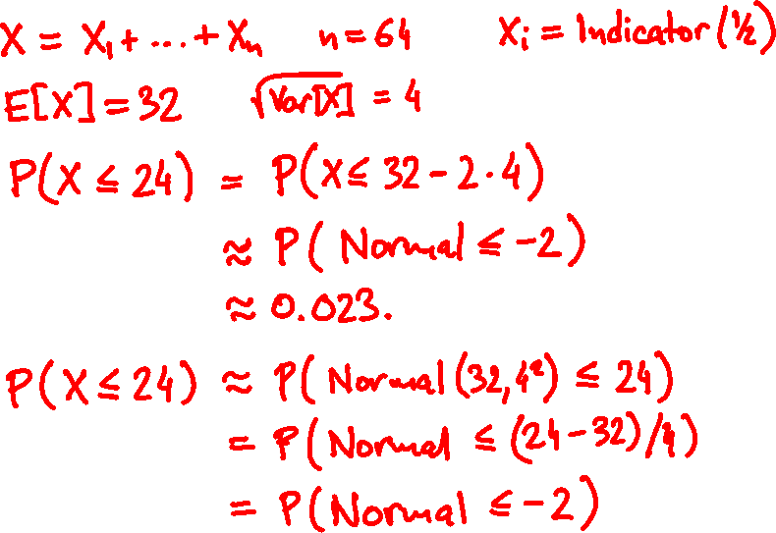
Probability of ≤ 24 heads in 64 coin flips?

Slide 21
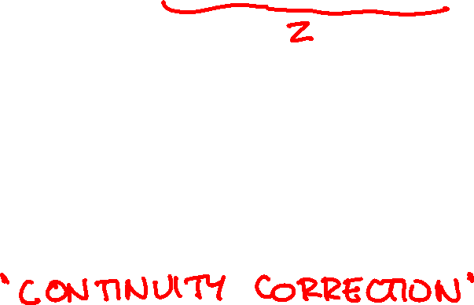
Normal approximation of Binomial
Binomial(n, p) ≈ Normal(np, np(1-p))
P(Binomial(n, p) ≤ t) ≈ P(Z ≤ t + 1/2))
P(Binomial(n, p) = t) ≈ P(t – 1/2 < Z ≤ t + 1/2)

Slide 22
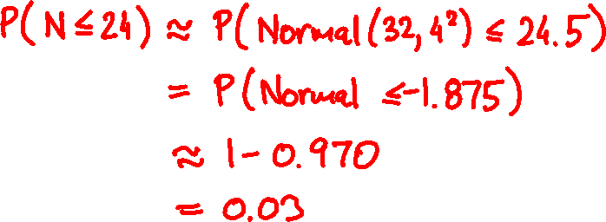
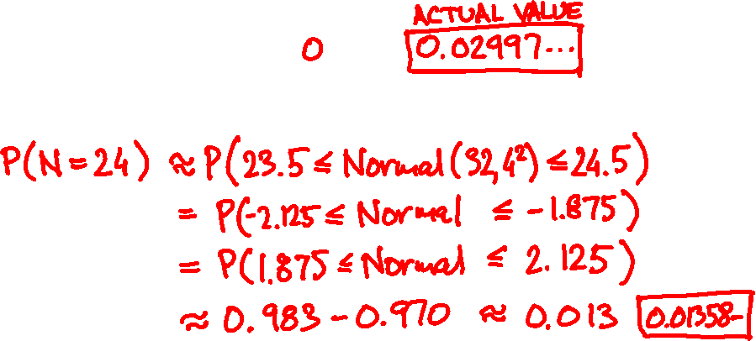
Probability of ≤ 24 heads in 64 coin flips?
Probability of = 24 heads?

Slide 24


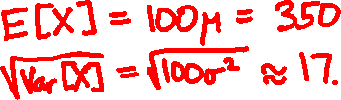
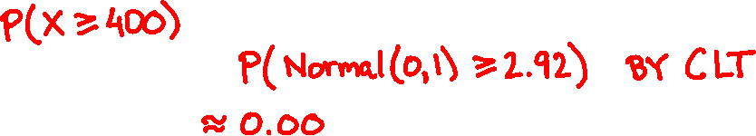
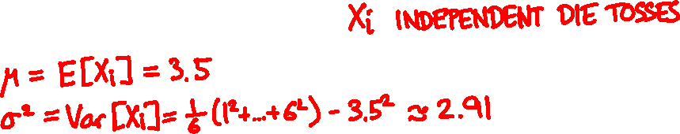

Toss a die 100 times. What is the probability that the sum of the outcomes exceeds 400?

Slide 25
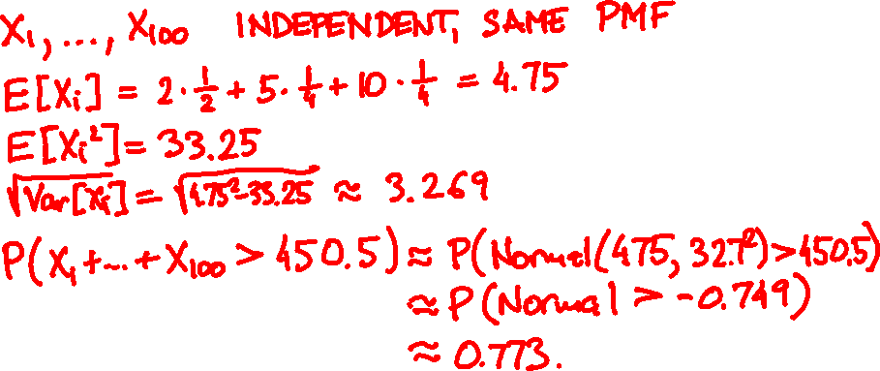
lollipop
toffee
truffle
price
$2
$5
$10
% of sales
50
25
25
100 customers are expected.
Estimate the probability that sales exceed $450

Slide 26
Approximations and limits
method
what you need
weakness
Markov’s
inequality
one-sided,
often imprecise
E[X] only
Chebyshev’s
inequality
sometimes
imprecise
E[X] and Var[X]
central limit
theorem
independence
many samples
estimate only

