Slide 1
2. Bayesian Statistics

Slide 2
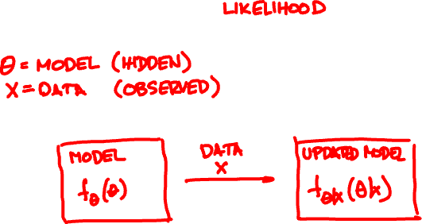
Bayes’ rule
f_{Θ|X}(θ | x) ∝ f_{X|Θ}(x | θ) f_{Θ}(θ)
posterior
prior

Slide 3

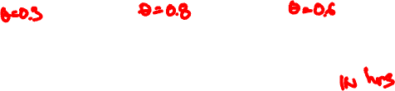
Romeo is waiting for Juliet on their first date.
👱‍♀️
👩🏾
👧🏻
X =
Uniform(0, .3)
Uniform(0, .8)
Uniform(0, .6)
girls are Uniform(0, Θ) late

Slide 4
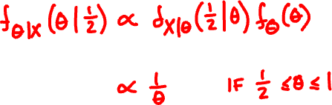
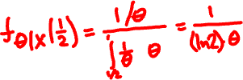


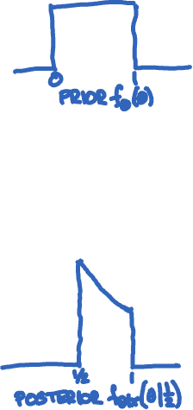
Romeo’s model
X = Uniform(0, Θ)
Θ = Uniform(0, 1)
On her first date, Juliet arrives ½ hour late.

Slide 5

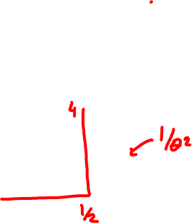
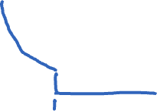
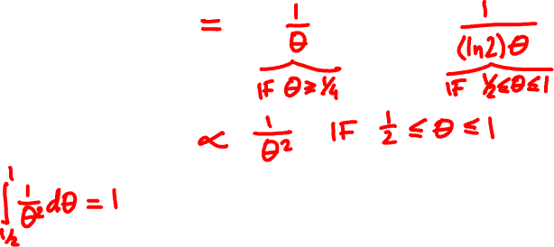

On her next date, Juliet arrives ¼ hour late.

Slide 6
Bayes’ rule for independent samples
f_{Θ|X …X}(θ|x₁,…, x_{n}) ∝ f_{X …X |Θ}(x₁,…, x_{n} |θ) f_{Θ}(θ)
₁
_{n}
₁
_{n}
= f_{X |Θ}(x₁|θ)…f_{X |Θ}(x_{n}|θ) f_{Θ}(θ)
₁
_{n}
if X₁, …, X_{n} are independent given Θ

Slide 7
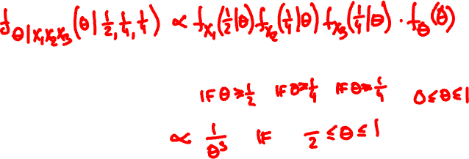
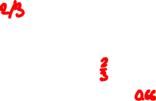
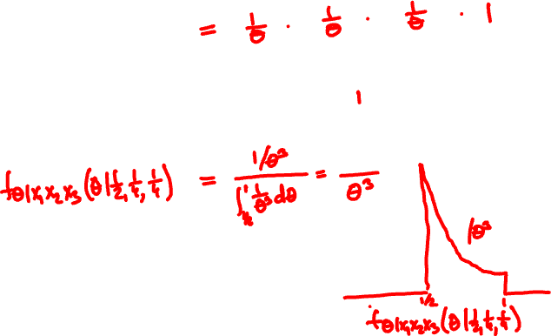
On her first 3 dates, Juliet is late by ½, ¼, ¼ hours.

Slide 8

CONGRATULATIONS!! 3/02
from: F48E5F6BRT@vega.ocn.ne.jp
to: andrejb@cse.cuhk.edu.hk
Dear Customer,
My name is Sandra Davis, Board of Directors of United Nations and Chief Executive Officer, effective April 16, 2018,
The United Nations {UN} has giving you extra three working days to receive your fund from Citibank Plc, New york or you will lose the opportunity for ever. So you are advised to comply immediately to avoid the cancellation of your fund, follow the instruction immediately for your own good and future
The Citibank controlling department controlling of the security transfer CODE which is (CI201), the Authentication section code of this bank concludes the verification of your file. After going through all the documents of claim received by this department with justification and verification from the global strategy United States we are completely satisfied and you have been confirmed.
The Citibank concerning wire transfers of your fund. Your letter has been referred to the (JMCB) Legal Division for Funds (US$2.8 Million Dollars) Transferred code (). We are satisfied using Electronic Wire Transfer or Swift Wire Transfer and the rights and liabilities of using of electronic and Swift fund transfer systems are defined by the Electronic Fund Transfer Act... The regulation, however, which implements this statute, Regulation E. specifically states that its provisions are inapplicable to a situation such we must ensure your Funds Transferred to your destination Bank Account between 72 hours.
Considering the volume of your payment, it is right for us to seek for the approval of some money regulatory Boards here in United States before we can carry out the Transfer of an amount of such magnitude to anybody, otherwise any such transfer will be stopped by the Authorities, and the International Monetary Fund (IMF), since your
Transfer is Electronic Transfer or Swift Wire transfer is almost activated with our bank and the only thing holding the final activation of your Account are some certain Approval Documents from the concerned Authorities here in United States
NB: THIS TRANSACTION IS BEING MONITORED BY THE UNITED STATES GOVERNMENT IN ORDER TO GUARDS US FROM INTERNET IMPOSTORS.
Provide your designated bank account details for Electronic Transfer, to avoid mistake(s).
Bank Name and Address
Account Number:
Account Name:
Routing Number:
your home adress and phone number,
place of work and address.
send it the citibank remittance manager. on her email : ombes2@gmx.com
UN gives you only 3 working days to receive your fund from our bank or no more so follow the instruction by sending email to us back with the bank detail details along with your personal details.
Thank you for giving us the opportunity to serve your banking needs. ombes2@gmx.com
Yours sincerely
Board of Directors of Citibank
Sandra Davis
Chief Executive Officer, effective April 16, 2018

Slide 9

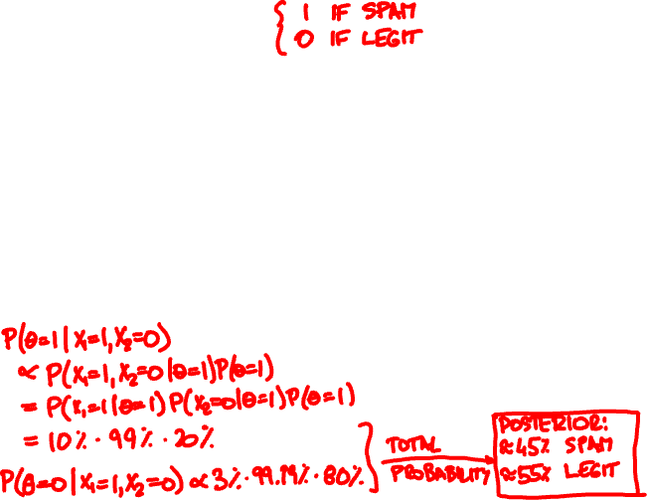


Θ = spam indicator
X₁ = contains “million dollars”
X₂ = contains “Nigerian princess”
θ
P(X₁| θ)
P(X₂| θ)
The Citibank concerning wire transfers of your fund. Your letter has been referred to the (JMCB) Legal Division for Funds (US$2.8 Million Dollars)
legit (0)
spam (1)

Slide 10
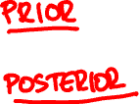
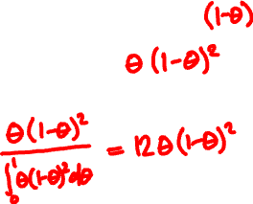
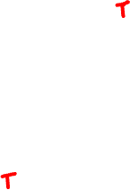
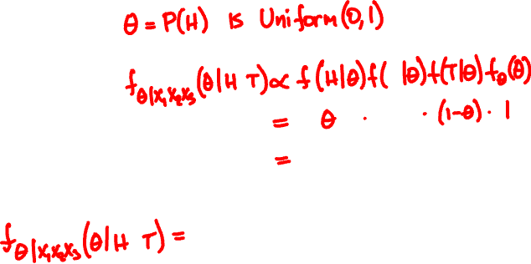
A coin of unknown bias flips HTT.
What is the bias?

Slide 11
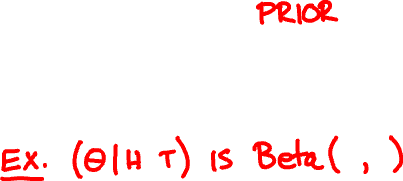
The Beta(α, β) random variable
Beta(1, 1) = Uniform(0, 1)
Θ is Beta(1, 1)
(Θ | h heads, t tails) is Beta(h + 1, t + 1)

Slide 12

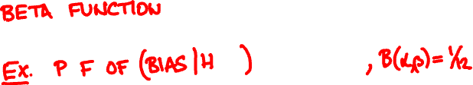
The Beta(α, β) random variable
1
f (θ) = θ^{α-1}(1-θ)^{β-1} when 0 < θ < 1
Β(α, β)
Β(α, β) = (α – 1)! (β – 1)! / (α + β – 1)!

Slide 13
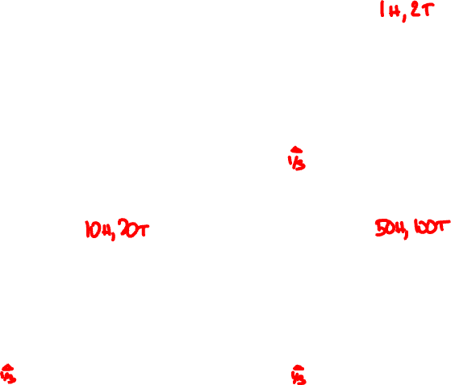
Beta(1, 1)
Beta(2, 3)
Beta(11, 21)
Beta(51, 101)

Slide 14
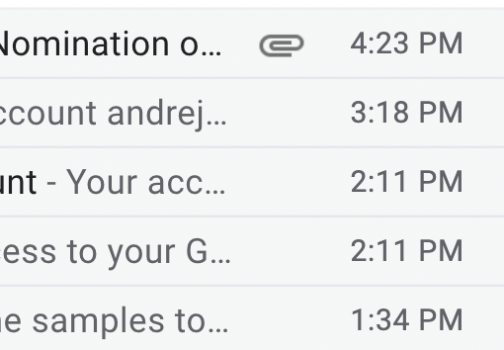
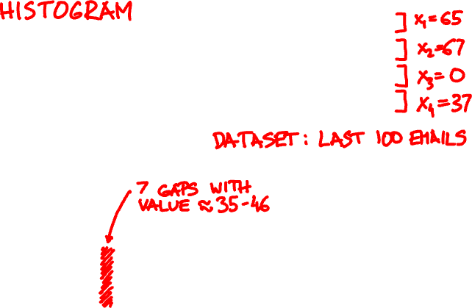
number of messages
interarrival time

Slide 15
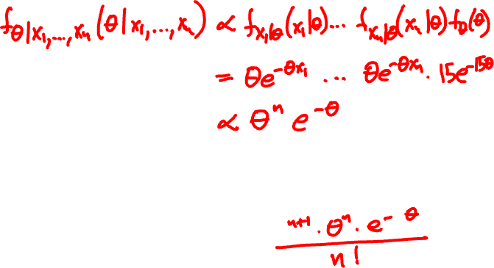
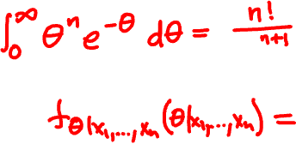


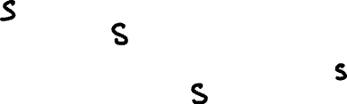
model
X₁, …, X_{n} = Exponential(Θ)
Θ = Exponential(15)

Slide 16
posterior PDF of Θ after
5 emails
20 emails
100 emails

Slide 17
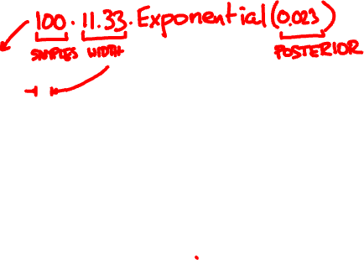

Slide 18
The Gamma(α, β) random variable
β^{α} θ^{α-1}e^{-βθ}
PDF f (θ)
=
(α - 1)!
model:
X₁,…,X_{n} are independent Exponential(Θ)
prior:
Θ is Exponential(x₀)
posterior:
Θ | X₁…X_{n} is Gamma(n + 1, x₀ + X₁ + … + X_{n})

Slide 19
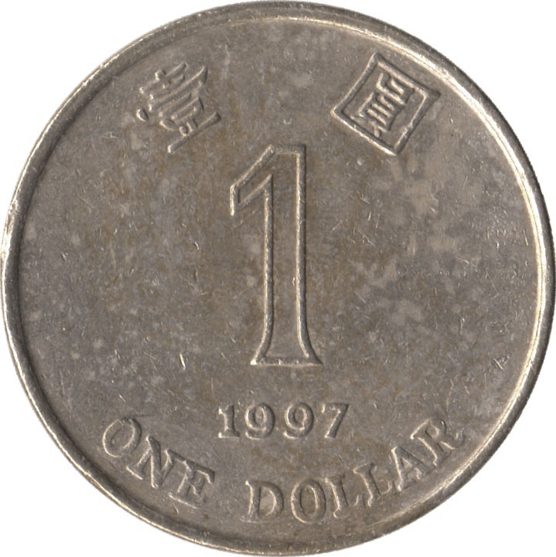
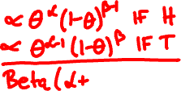



Conjugate priors
prior:
posterior:
Indicator(Θ)
Beta(α, β)
f _{Θ}(θ) ∝ θ^{α-1}(1-θ)^{β-1}
Exponential(Θ)
Gamma(α, β)
f _{Θ}(θ) ∝ θ^{α-1}e^{-βθ}

Slide 20

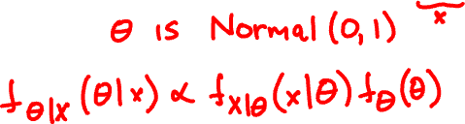




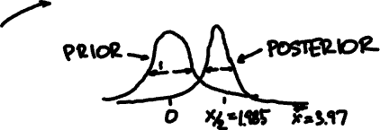

A Normal(Θ, 1) RVs takes value 3.97. What is Θ?

Slide 21
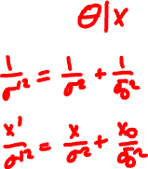

Conjugate prior for normal mean
prior:
Θ is Normal(x₀, σ₀)
likelihood:
X is Normal(Θ, σ)
posterior:

Slide 22

Inference for Normals
X_{i} = Normal(Θ, σ_{i}) independent given Θ
Θ is Normal(x₀, σ₀)
(Θ | X₁ = x₁, …, X_{n} = x_{n}) is Normal(x, σ) where
1/σ² = 1/σ₀² + … + 1/σ_{n}²
x/σ² = x₀/σ₀² + … + x_{n}/σ_{n}²

Slide 23
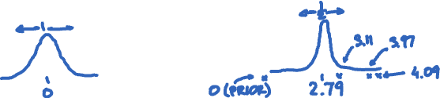


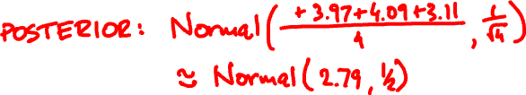
Three independent Normal(Θ, 1) RVs take values 3.97, 4.09, 3.11. What is Θ?

