Slide 1
7. Confidence intervals II

Slide 2
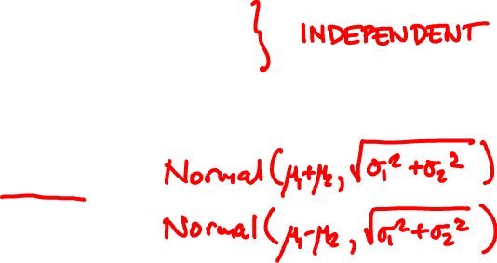
Normal algebra review
X₁ is Normal(μ₁, σ₁)
X₂ is Normal(μ₂, σ₂)
X₁ + X₂ is
X₁ – X₂ is

Slide 3
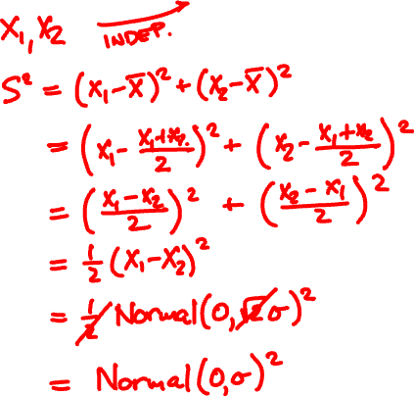
What is the adjusted sample variance S² of two independent Normal(μ, σ) samples?

Slide 4
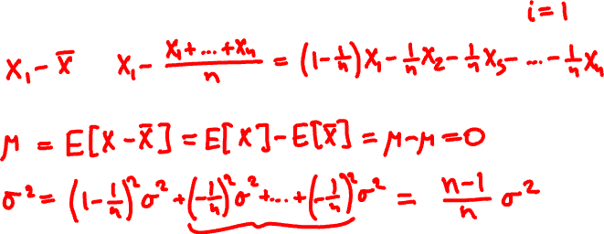


(X₁ – X)² + … + (X_{n} – X)²
S² =
n – 1
X_{i} independent Normal(μ, σ)
What kind of random variable is X_{i} – X?

Slide 5

The χ²(k) random variable
X² = N₁² + … + N_{k}²
N₁,…,N_{k} are independent Normal(0, 1)
k = 1, 2, 5
k = 10, 20
PDF: f(x) ∝ x^{k/2 – 1}e^{–x/2}

Slide 6
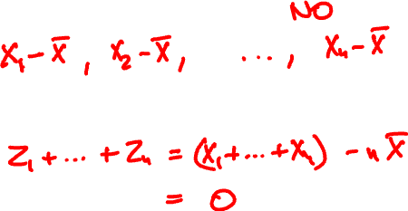

(X₁ – X)² + … + (X_{n} – X)²
S² =
n – 1
X_{i} independent Normal(μ, σ)
Are they independent?

Slide 7
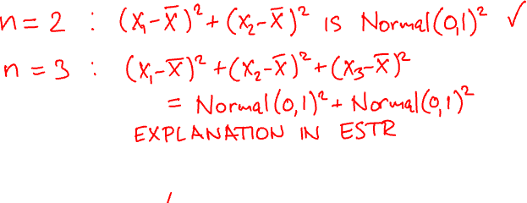
X₁, …, X_{n} independent Normal(μ, 1)
(X₁ – X)² + … + (X_{n} – X)²
is a χ²(n – 1) r.v.
X₁, …, X_{n} independent Normal(μ, σ)
(n – 1)S²/σ ² is a χ²(n – 1) r.v.

Slide 8
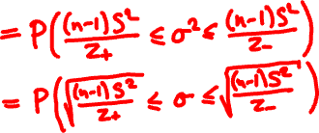

Confidence intervals for Normal(μ, σ)
https://homepage.divms.uiowa.edu/~mbognar/applets/chisq.html

Slide 9

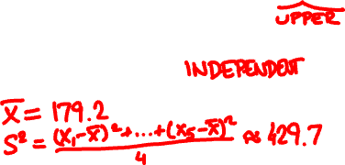
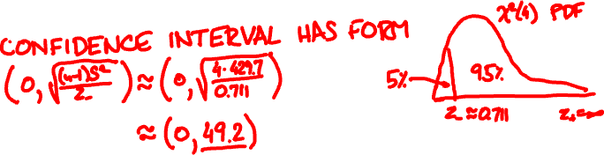
Five random athletes are 152, 163, 188, 201, 192 cm tall. Give a 95%-confidence limit for σ

Slide 10
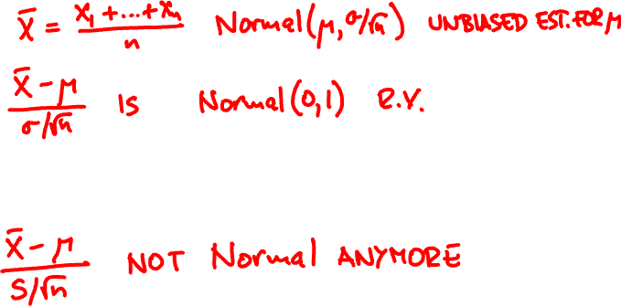


Estimating Normal(μ, σ)
X₁, …, X_{n} independent Normal(μ, σ)

Slide 11
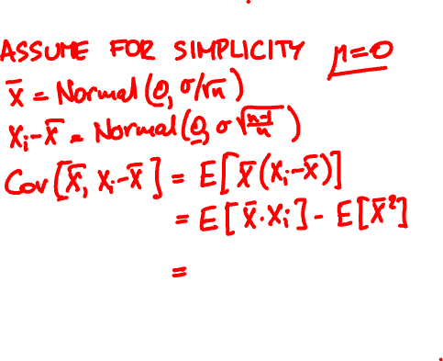
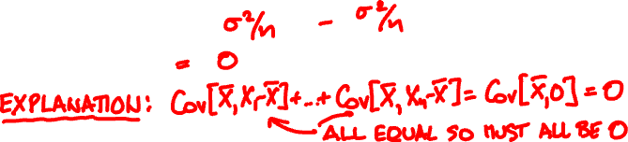
What is the covariance of X and X_{i} – X?
Cov[X, Y] = E[(X – E[X])(Y – E[Y])] = E[XY] – E[X]E[Y]

Slide 12
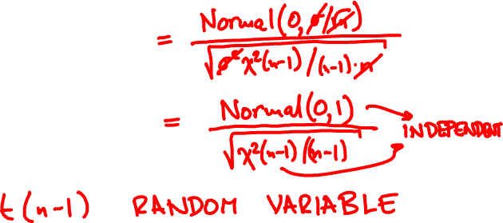
X₁, …, X_{n} independent Normal(μ, σ)
X and S² are independent
X – μ
T =
S/√n

Slide 13
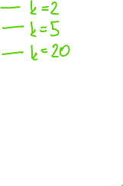
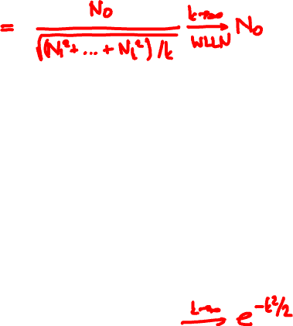
The t(k) (student) random variable
Normal(0, 1)
t(k) =
√χ²(k)/k
PDF: f(x) ∝ (1 + x²/k)^{–(k + 1)/2}

Slide 14

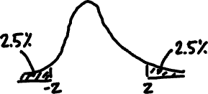
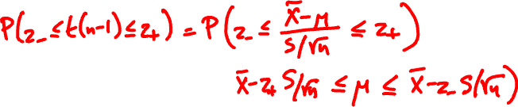
Confidence intervals for Normal(μ, σ)
https://homepage.divms.uiowa.edu/~mbognar/applets/t.html

Slide 15
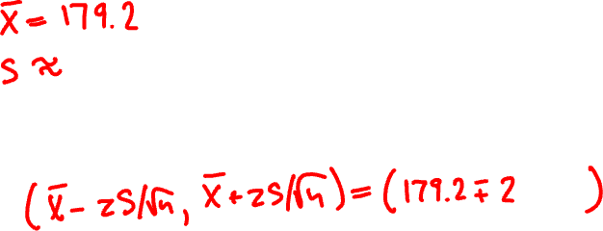

Five random athletes are 152, 163, 188, 201, 192 cm tall. Give a 95%-confidence int’l for μ

Slide 16
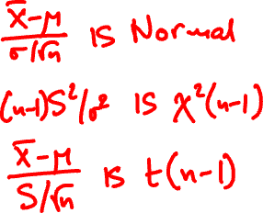

Confidence intervals for Normal(μ, σ)
μ with known σ
σ
μ with unknown σ

Slide 17
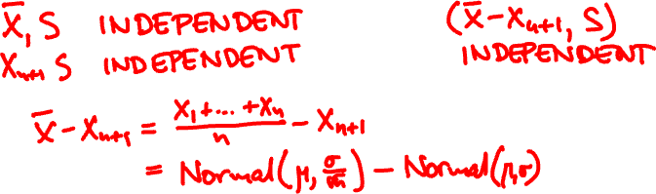




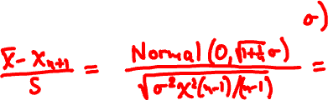
X = n-sample mean
S² = normalized n-sample variance
X_{n+1} = next sample
What is the PDF of (X – X_{n+1})/S?

Slide 18
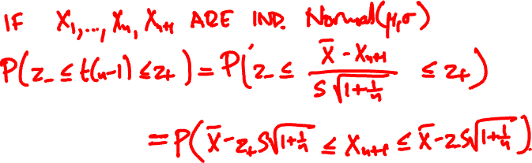
Prediction intervals for Normal(μ, σ)
^
^
A p-prediction interval is a pair Θ–, Θ₊ so that
^
^
P(Θ– ≤ X_{n+1} ≤ Θ₊) ≥ p

Slide 19

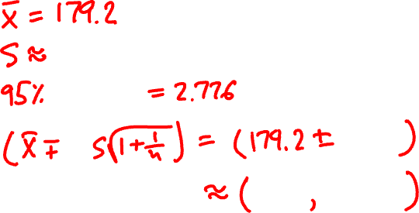
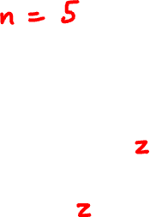

Five random athletes are 152, 163, 188, 201, 192 cm tall. Give a 95%-prediction int’l for next

Slide 20
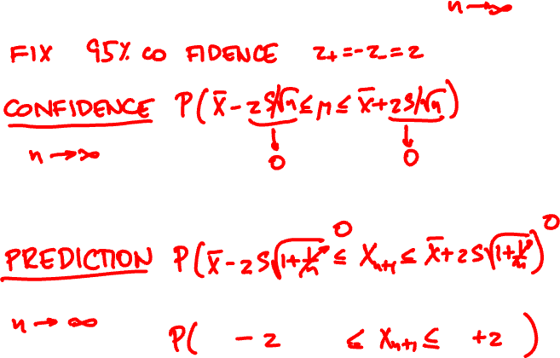


Prediction vs confidence in the limit

